Slide 1
Not Without Law
Romans 2:11-16

Slide 2
God has given man law from the beginning..
Romans 2:11-16 For as many as have sinned without law will also perish without law, and as many as have sinned in the law will be judged by the law .. 14 for when Gentiles, who do not have the law, by nature do the things in the law, these, although not having the law, are a law to themselves, 15 who show the work of the law written in their hearts..

Slide 3
God’s plan promised before time began..
Titus 1:2 in hope of eternal life which God, who cannot lie, promised before time began..
2 Tim 1:9 who has saved us and called us with a holy calling, not according to our works, but according to His own purpose and grace which was given to us in Christ Jesus before time began..

Slide 4
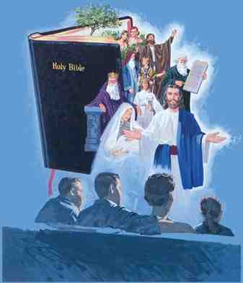
Visualized Bible Study series..

Slide 6
Why we need Bible study..
2 Tim 2:15 Be diligent to present yourself approved to God, a worker who does not need to be ashamed, rightly dividing the word of truth.

Slide 7
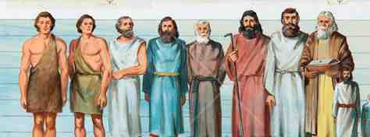
Patriarchal Age..
Moral Law from the beginning..
2500 yrs – From Adam to Moses
(Genesis – Exodus 1-19 – Job)
1st sin in the garden .. Gen 3:1-22
Cain killed brother.. Gn 4; 1 Jn 3:12
Noah preached righteousness Gn 6
Pharaoh & Abram’s wife Gen 12:10ff
Abraham intercedes for Sodom Gn 19
Unbelief & immorality were without excuse

Slide 8
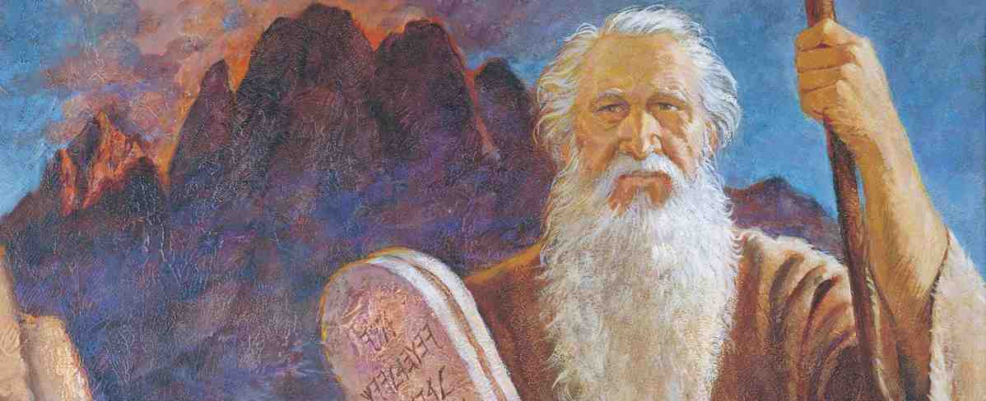
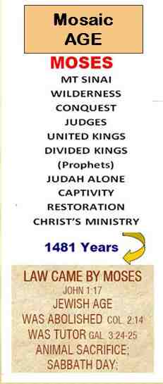
Mosiac Age..
Mosaic Law for the Israelites.. (1500 yrs .. From Moses to Christ)
Designed as temporary.. Jer 31:31-34
Law served as a tutor.. Gal 3:19-25
Separated Jew & Gentile..Eph 2:11-18
Christ fulfilled the law.. Matt 5:17
LAW of MOSES
Was moral law abolished?

Slide 9
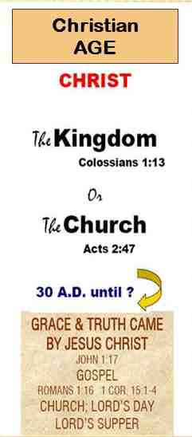
Christian Age..
Gospel Law of Liberty for All.. (2000 yrs – Until Christ returns)
Gospel is for Jew & Greek.. Rom 1:16
Possible by Christ’s blood.. Heb 10:4
Law of spirit of life.. Rom 8:2-3
Law of Christ/Liberty.. Gal 6:2; Jas 1:25; 2:12; John 12:48
CHRISTIAN AGE
We need law.. We need grace, forgiveness

Slide 10
Not Without Law
Romans 2:11-16

