Slide 1
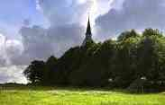
The Certified Gospel
Galatians 1:6-12

Slide 2
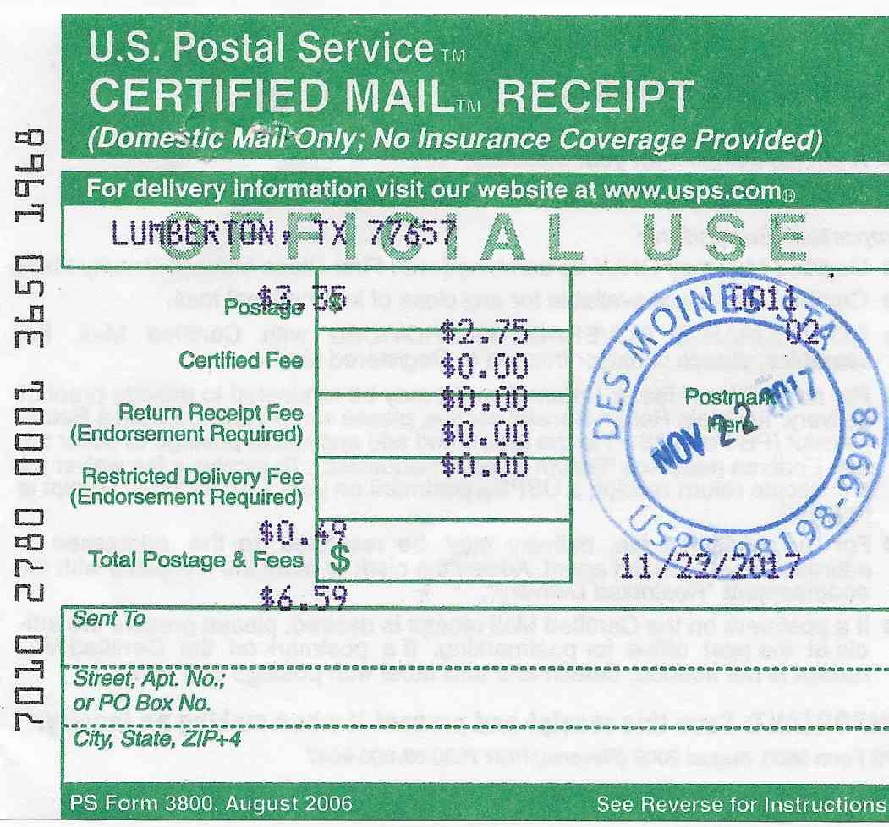

Slide 3
The gospel certified
Gal 1:11-12: “But I certify you, brethren, that the gospel which was preached of me is not after man. For I neither received it of man, neither was I taught it, but by the revelation of Jesus Christ."
“Euaggelion” = Good News

Slide 4
Four things we need to know..
The Gospel Facts - 1 Corinthians 15:1-4
Death of Jesus
Burial of Jesus
Resurrection of Jesus
1 Peter 2:24
Luke 23:50-53
Luke 24:1-7

Slide 5
Four things we need to know..
The Gospel Truths - Romans 1:16-17
God’s exclusive power to save Gal 1:6-8
Provided for all of humanity Titus 2:11-12
Our only way of reconciliation 2 Cor 5:17-21

Slide 6
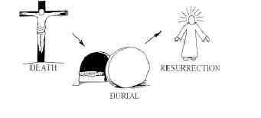
Four things we need to know..
The Gospel Plan - Mark 16:15-16
Belief in Christ John 8:24 Matt 10:32-33
Repentance requires change Luke 13:3 2 Pet 3:9
Baptism procures rebirth Romans 6:3-7 Tit 3:3-5

Slide 7
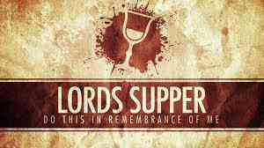
Four things we need to know..
The Gospel Memorial - 1 Cor 11:23-26
Memorial: In remembrance of Me vs 24-25
Perpetual: Until He comes vs 26
First day of the week Acts 2:42 20:7 1 Cor 16:2

Slide 8
The Certified Gospel
The Gospel Facts 1 Cor 15:1-4
The Gospel Truths Romans 1:16-17
The Gospel Plan Mark 16:15-16
The Gospel Memorial 1 Cor 11:23-26

Slide 9
The Certified Gospel
Galatians 1:6-12

