Slide 1
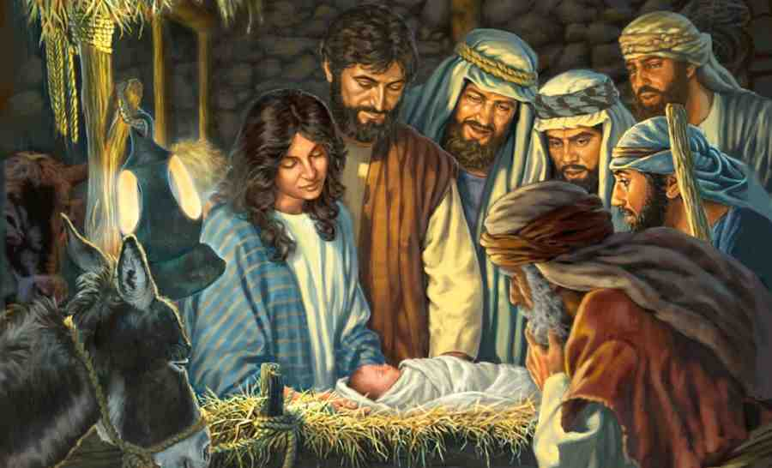
The Story of Jesus’ Birth
Luke 2:4-11

Slide 2
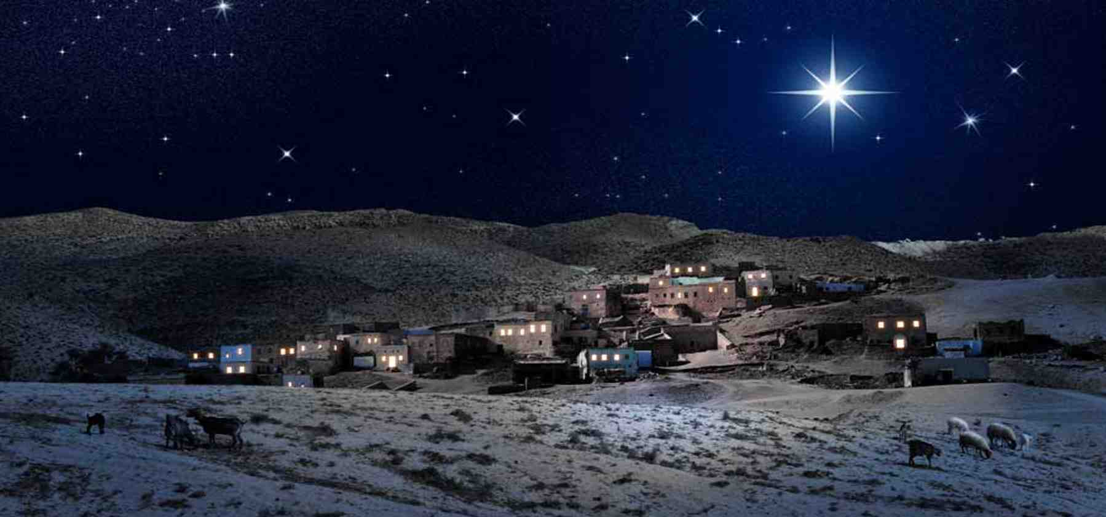
1 Part of God’s Eternal Plan
Luke 2:1-4 And it came to pass in those days that a decree went out from Caesar Augustus that all the world should be registered. 2 This census first took place while Quirinius was governing Syria.
3 So all went to be registered, everyone to his own city. 4 Joseph also went up from Galilee, out of the city of Nazareth, into Judea, to the city of David, which is called Bethlehem, because he was of the house and lineage of David..

Slide 3
2 Different from what we expect
Luke 2:5-9 He went there to register with Mary, who was pledged to be married to him and was expecting a child. 6 While they were there, the time came for the baby to be born, 7 and she gave birth to her firstborn, a son. She wrapped him in cloths and placed him in a manger, because there was no guest room available for them.
8 And there were shepherds living out in the fields nearby, keeping watch over their flocks at night. 9 An angel of the Lord appeared to them, and the glory of the Lord shone around them, and they were terrified.

Slide 4
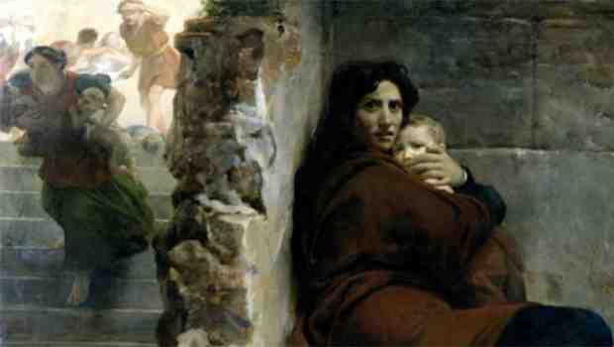
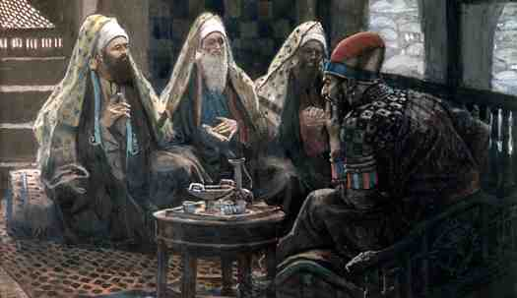
3 Beginning of a long war
Matt 2:1-5 Now after Jesus was born in Bethlehem of Judea in the days of Herod the king, behold, wise men from the East came to Jerusalem, 2 saying, "Where is He who has been born King of the Jews? For we have seen His star in the East and have come to worship Him."
3 When Herod the king heard this, he was troubled, and all Jerusalem with him. 4 And when he had gathered all the chief priests and scribes of the people together, he inquired of them where the Christ was to be born. 5 So they said to him, "In Bethlehem of Judea, for thus it is written by the prophet”..

Slide 5
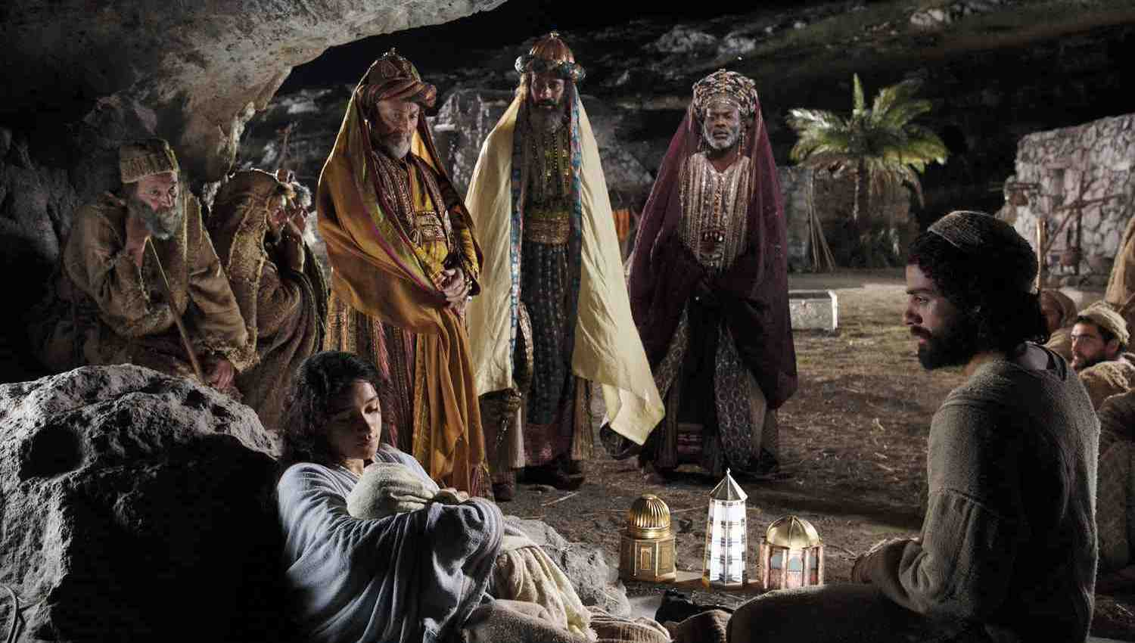
3 The beginning of a long war
Matt 2:7-9 Then Herod, when he had secretly called the wise men, determined from them what time the star appeared. 8 And he sent them to Bethlehem and said, "Go and search carefully for the young Child, and when you have found Him, bring back word to me, that I may come and worship Him also."
9 When they heard the king, they departed; and behold, the star which they had seen in the East went before them, till it came and stood over where the young Child was.

Slide 6
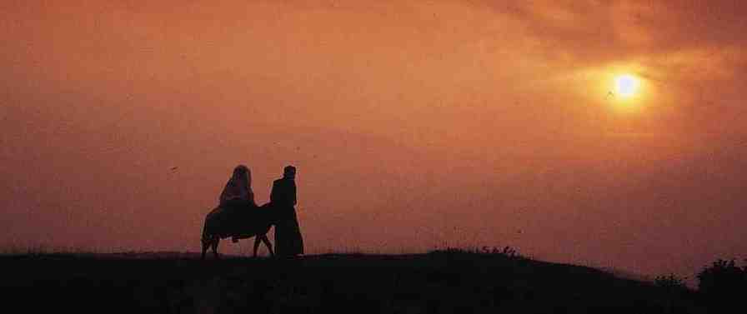
3 The beginning of a long war
Matt 2:12-14 Then, being divinely warned in a dream that they should not return to Herod, they departed for their own country another way.
13 Now when they had departed, behold, an angel of the Lord appeared to Joseph in a dream, saying, "Arise, take the young Child and His mother, flee to Egypt, and stay there until I bring you word; for Herod will seek the young Child to destroy Him." 14 When he arose, he took the young Child and His mother by night and departed for Egypt,

Slide 7
3 The beginning of a long war
Matt 2:16-18 Then Herod, when he saw that he was deceived by the wise men, was exceedingly angry; and he sent forth and put to death all the male children who were in Bethlehem and in all its districts, from two years old and under, according to the time which he had determined from the wise men.

Slide 8
The birth of Jesus..
We don’t know the day..
There is a lot misunderstood
An event unlike any other

Slide 9
The Story of Jesus’ Birth
Luke 2:4-11

