Slide 1



We Make it our Aim
2 Corinthians 5:1-10

Slide 2

Finding a Purpose in Life
Economic (financially secure)
Socially (good family, relationships)
Physically (healthy, long life)

Slide 3

1 Importance of Aim
For this life only..
  Eccl 1:13-14 I have seen all the works that are done under the sun; and indeed, all is vanity and grasping for the wind.
  Eccl 12:13-14 – Let us hear the conclusion of the whole matter: Fear God and keep His commandments, For this is man’s all. 14 For God will bring every work into judgment, including every secret thing, Whether good or evil.

Slide 4
1 Importance of Aim
Paul.. The aim for Christians
  2 Cor 5:1-8 1 For we know that if our earthly house, this tent, is destroyed, we have a building from God, a house not made with hands, eternal in the heavens. 2 For in this we groan, earnestly desiring to be clothed with our habitation which is from heaven, 3 if indeed, having been clothed, we shall not be found naked. 4 For we who are in this tent groan, being burdened, not because we want to be unclothed, but further clothed, that mortality may be swallowed up by life.

Slide 5
1 Importance of Aim
We are prepared for this by God
  5 Now He who has prepared us for this very thing is God, who also has given us the Spirit as a guarantee. 6 So we are always confident, knowing that while we are at home in the body we are absent from the Lord. 7 For we walk by faith, not by sight. 8 We are confident, yes, well pleased rather to be absent from the body and to be present with the Lord.

Slide 6
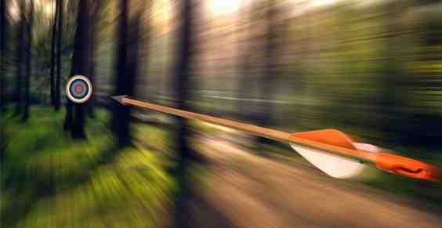

2 We Make it Our Aim
2 Cor. 5:9 “Therefore we make it our aim, whether present or absent, to be well pleasing to Him.”
  Aim.. out of a sense of honor
  Privilege of being pleasing to God

Slide 7
2 We Make it Our Aim
Heb 13:20-21 may the God of peace who brought up our Lord Jesus from the dead, that great Shepherd of the sheep, through the blood of the everlasting covenant, make you complete in every good work to do His will, working in you what is well pleasing in His sight, through Jesus Christ, to whom be glory forever and ever. Amen.
  All encompassing
  Constantly tested

Slide 8
2 We Make it Our Aim
Requires deliberate choice..
  Phil 1:9-11 “And this I pray, that your love may abound still more and more in knowledge and all discernment, that you may approve the things that are excellent, that you may be sincere and without offense till the day of Christ, being filled with the fruits of righteousness which are by Jesus Christ, to the glory and praise of God.”

Slide 9

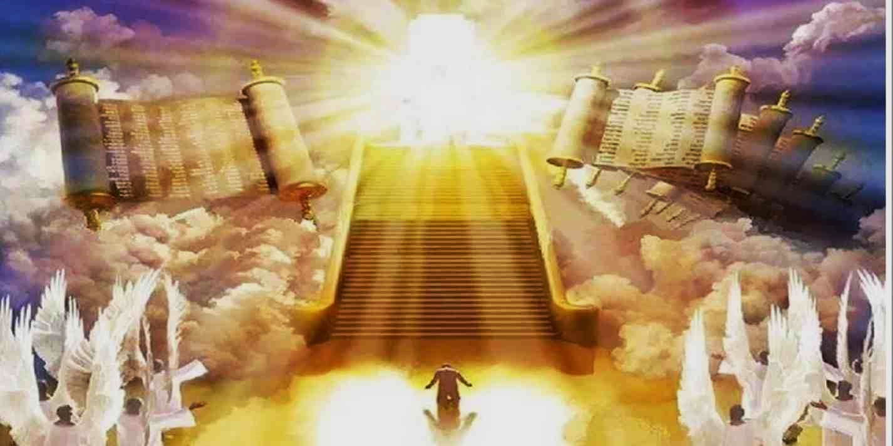
3 Ultimate appointment
Accountability to God..
  2 Cor. 5:10 “For we must all appear before the judgment seat of Christ, that each one may receive the things done in the body, according to what he has done, whether good or bad”
  Appear (personal appearing, to make known)
  In the body (this life) what we have done

Slide 10
3 Ultimate appointment
Our aim to appear comfortably..
  2 Pet. 3:10-11 Therefore, since all these things will be dissolved, what manner of persons ought you to be in holy conduct and godliness, looking for and hastening the coming of the day of God, because of which the heavens will be dissolved, being on fire, and the elements will melt with fervent heat?”

Slide 11
We Make it our Aim
2 Corinthians 5:1-10

