Slide 1
If You Want to Follow Jesus
Luke 9:18-26

Slide 2
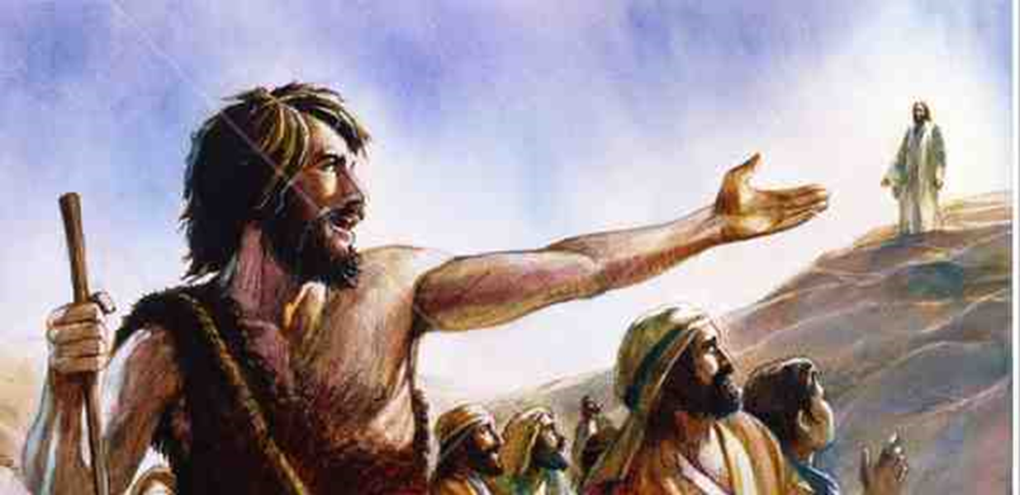
Behold the Lamb of God
John 1:40-49.. “We have found the Messiah”..
They followed Him..

Slide 3
We are called to follow..
Luke 9:23-26 Then He said to them all, “If anyone desires to come after Me, let him deny himself, and take up his cross daily, and follow Me.
24 For whoever desires to save his life will lose it, but whoever loses his life for My sake will save it. 25 For what profit is it to a man if he gains the whole world, and is himself destroyed or lost?
26 For whoever is ashamed of Me and My words, of him the Son of Man will be ashamed when He comes in His own glory, and in His Father’s, and of the holy angels.
The heart of the gospel ..

Slide 4
1 A Principle
23 “If anyone desires to come after Me, let him deny himself, and take up his cross daily, and follow Me
Deny yourself..
What I want no longer matters..
Give myself up to allow God to save me..

Slide 5
2 A Paradox
24-25 For whoever desires to save his life will lose it, but whoever loses his life for My sake will save it. 25 For what profit is it to a man if he gains the whole world, and is himself destroyed or lost?
A choice of two ways..
The narrow gate (Jesus)
“Strive” to enter (Luke 13:24)
“With all your heart (Jer 29:13)

Slide 6
3 A Prediction
26 For whoever is ashamed of Me and My words, of him the Son of Man will be ashamed when He comes in His own glory, and in His Father’s, and of the holy angels.
Challenge to make the right choice..
Those who will not repent will be ashamed
Ashamed of him.. Ashamed of by Him

Slide 7
The coming day
Rev 20:11-12 Then I saw a great white throne and Him who sat on it, from whose face the earth and the heaven fled away. And there was found no place for them.
12 And I saw the dead, small and great, standing before God, and books were opened. And another book was opened, which is the Book of Life. And the dead were judged according to their works, by the things which were written in the books.

Slide 8
If You Want to Follow Jesus
Luke 9:18-26

