Slide 1
Live by the Book
2 Timothy 3:1-17

Slide 2
“A Bible that's falling apart usually belongs to someone who isn't..”

Slide 3
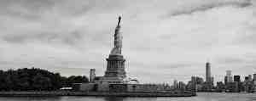
1-9 Explanation.. Last days
1-5 What we are living and ministering in..
6-7 Importance of spiritual discernment..
8-9 Word of Encouragement..

Slide 4
1-5 Difficult times
¹ But know this, that in the last days perilous times will come: ² For men will be lovers of themselves, lovers of money, boasters, proud, blasphemers, disobedient to parents, unthankful, unholy, ³ unloving, unforgiving, slanderers, without self-control, brutal, despisers of good, ⁴ traitors, headstrong, haughty, lovers of pleasure rather than lovers of God, ⁵ having a form of godliness but denying its power. And from such people turn away!

Slide 5
6-7 Need for discernment
⁶ For of this sort are those who creep into households and make captives of gullible women loaded down with sins, led away by various lusts, ⁷ always learning and never able to come to the knowledge of the truth.
8-9 The truth will prevail
- ⁸ Now as Jannes and Jambres resisted Moses, so do these also resist the truth: men of corrupt minds, disapproved concerning the faith; ⁹ but they will progress no further, for their folly will be manifest to all, as theirs also was.

Slide 6
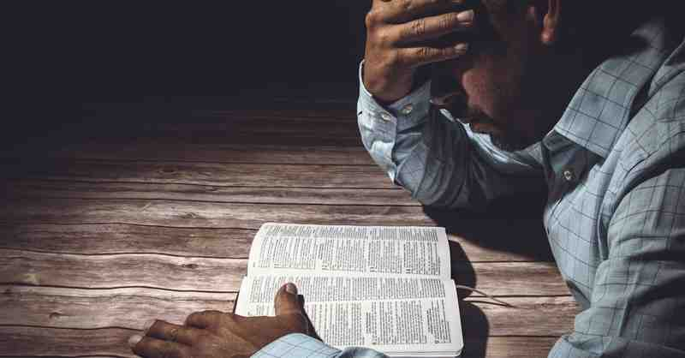
10-17 Live by the scriptures
10-13 Follow my example
14-15 Continue in the scriptures
16-17 Why we live by the book

Slide 7
10-13 Godly example
¹⁰ But you have carefully followed my doctrine, manner of life, purpose, faith, longsuffering, love, perseverance, ¹¹ persecutions, afflictions, which happened to me at Antioch, at Iconium, at Lystra—what persecutions I endured. And out of them all the Lord delivered me. ¹² Yes, and all who desire to live godly in Christ Jesus will suffer persecution. ¹³ But evil men and impostors will grow worse and worse, deceiving and being deceived.

Slide 8
14-15 Continue in the scriptures
¹⁴ But you must continue in the things which you have learned and been assured of, knowing from whom you have learned them, ¹⁵ and that from childhood you have known the Holy Scriptures, which are able to make you wise for salvation through faith which is in Christ Jesus.

Slide 9
16-17 Why we live by the book..
¹⁶ All Scripture is given by inspiration of God, and is profitable for doctrine, for reproof, for correction, for instruction in righteousness, ¹⁷ that the man of God may be complete, thoroughly equipped for every good work.

Slide 10
Live by the Book
2 Timothy 3:1-17

