Slide 1
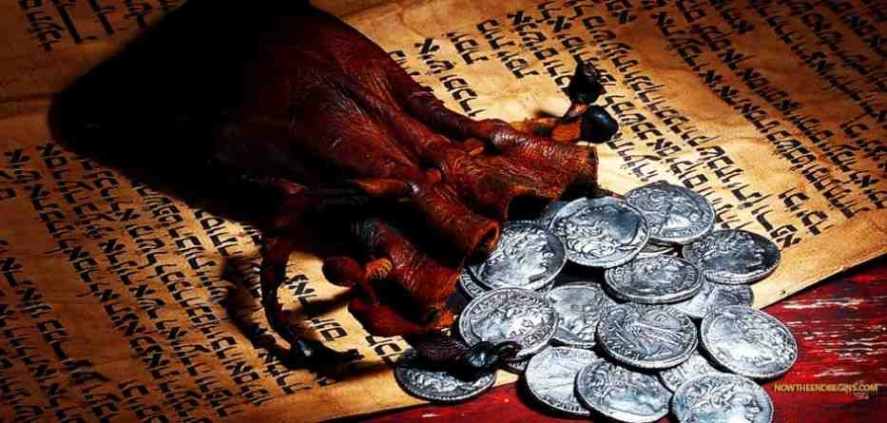
Unmasking the Betrayer
John 13:18-30

Slide 2
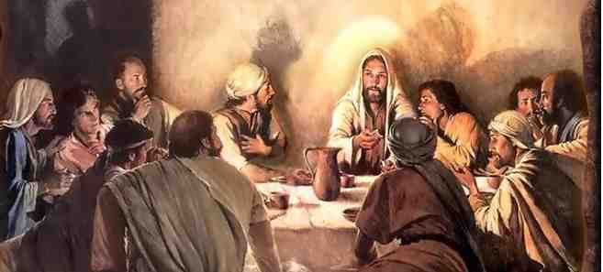
Jesus reveals the traitor..
Anticipation.. Vs 18-19
“I do not speak concerning all of you. I know whom I have chosen; but that the Scripture may be fulfilled, ‘He who eats bread with Me has lifted up his heel against Me.’ ¹⁹ Now I tell you before it comes, that when it does come to pass, you may believe that I am He.

Slide 3
Jesus reveals the traitor..
Anticipation.. vs 18-19
Announcement .. 20-21
Most assuredly, I say to you, he who receives whomever I send receives Me; and he who receives Me receives Him who sent Me.”²¹ When Jesus had said these things, He was troubled in spirit, and testified and said, “Most assuredly, I say to you, one of you will betray Me.”

Slide 4
Jesus reveals the traitor..
Anticipation.. vs 18-19
Announcement .. 20-21
Astonishment .. 22-25
Then the disciples looked at one another, perplexed about whom He spoke.²³ Now there was leaning on Jesus’ bosom one of His disciples, whom Jesus loved. ²⁴ Simon Peter therefore motioned to him to ask who it was of whom He spoke.²⁵ Then, leaning back on Jesus’ breast, he said to Him, “Lord, who is it?”

Slide 5
Jesus reveals the traitor..
Addressed.. 26-30
²⁶ Jesus answered, “It is he to whom I shall give a piece of bread when I have dipped it.” And having dipped the bread, He gave it to Judas Iscariot, the son of Simon. ²⁷ Now after the piece of bread, Satan entered him. Then Jesus said to him, “What you do, do quickly.” ²⁸ But no one at the table knew for what reason He said this to him. ²⁹ For some thought, because Judas had the money box, that Jesus had said to him, “Buy those things we need for the feast,” or that he should give something to the poor.³⁰ Having received the piece of bread, he then went out immediately. And it was night.

Slide 6
Questions we must answer
Can Satan prevent Christ fulfilling His plans?
Does enjoying spiritual privileges always make a person faithful to Christ?
Will the opportunity to repent be accepted?

Slide 7
Unmasking the Betrayer
John 13:18-30

