Slide 1
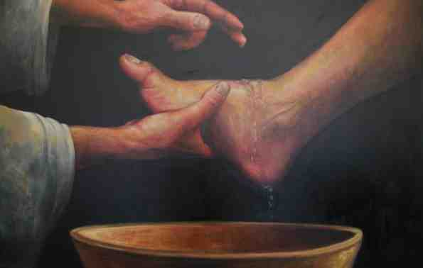
The Humility of Love
John 13:1-17

Slide 2
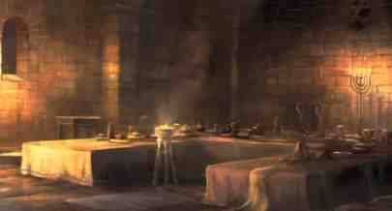
Upper Room (John 13-16)
Jesus with the 12 apostles..
The night before His death
His last time to be with them
Showing how He loved them

Slide 3
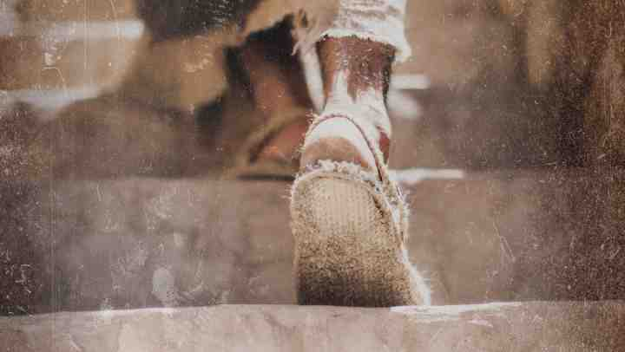
Walking dusty roads..
Custom of Jewish homes..
Basin of water at entrance
Duty of lowest servant

Slide 4
Missed opportunity
Matt 20:26-27 whoever desires to become great among you, let him be your servant. ²⁷ And whoever desires to be first among you, let him be your slave—
Luke 22:24-26 Now there was also a dispute among them, as to which of them should be considered the greatest..

Slide 5
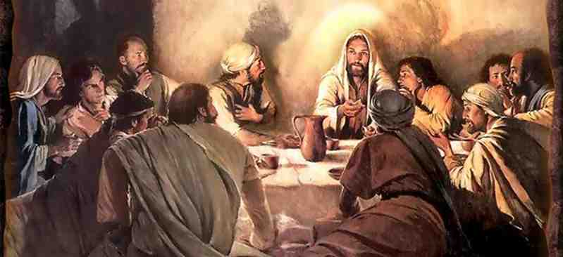
1-5 He loved them ..
John 13:1 Now before the Feast of the Passover, when Jesus knew that His hour had come that He should depart from this world to the Father, having loved His own who were in the world, He loved them to the end.

Slide 6
He loved them ..
John 13:2 And supper being ended, the devil having already put it into the heart of Judas Iscariot, Simon’s son, to betray Him..

Slide 7
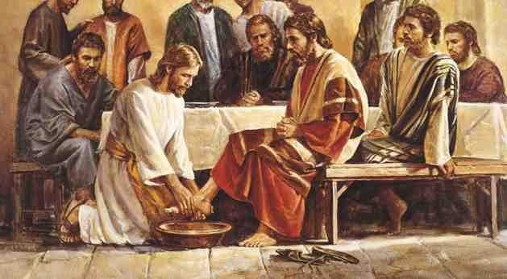
He loved them ..
John 13:4-5 rose from supper and laid aside His garments, took a towel and girded Himself. ⁵ After that, He poured water into a basin and began to wash the disciples’ feet, and to wipe them with the towel with which He was girded.

Slide 8
5-11 Peter’s reaction..
5-8 After that, He poured water into a basin and began to wash the disciples’ feet, and to wipe them with the towel with which He was girded. ⁶ Then He came to Simon Peter. And Peter said to Him, “Lord, are You washing my feet?”
⁷ Jesus answered and said to him, “What I am doing you do not understand now, but you will know after this.”⁸ Peter said to Him, “You shall never wash my feet!”

Slide 9
Jesus’ assurance..
8-11 Jesus answered him, “If I do not wash you, you have no part with Me.” ⁹ Simon Peter said to Him, “Lord, not my feet only, but also my hands and my head!”
¹⁰ Jesus said to him, “He who is bathed needs only to wash his feet, but is completely clean; and you are clean, but not all of you.” ¹¹ For He knew who would betray Him; therefore He said, “You are not all clean.”

Slide 10
12-17 Jesus’ real lesson..
12 So when He had washed their feet, taken His garments, and sat down again, He said to them, “Do you know what I have done to you? ¹³ You call Me Teacher and Lord, and you say well, for so I am. ¹⁴ If I then, your Lord and Teacher, have washed yo ur feet, you also ought to wash one another’s feet.

Slide 11
12-17 Jesus’ example..
¹⁵ For I have given you an example, that you should do as I have done to you. ¹⁶ Most assuredly, I say to you, a servant is not greater than his master; nor is he who is sent greater than he who sent him. ¹⁷ If you know these things, blessed are you if you do them.

Slide 12
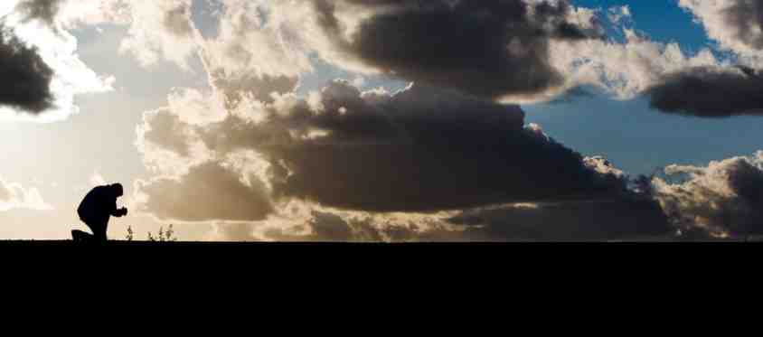
Humility loving service
Develop a servant’s heart..
Be willing to do the lowly tasks..

Slide 13
The Humility of Love
John 13:1-17

