Slide 1
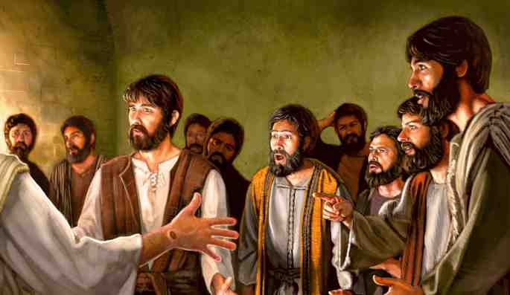
By Many Infallible Proofs
Acts 1:1-3

Slide 2
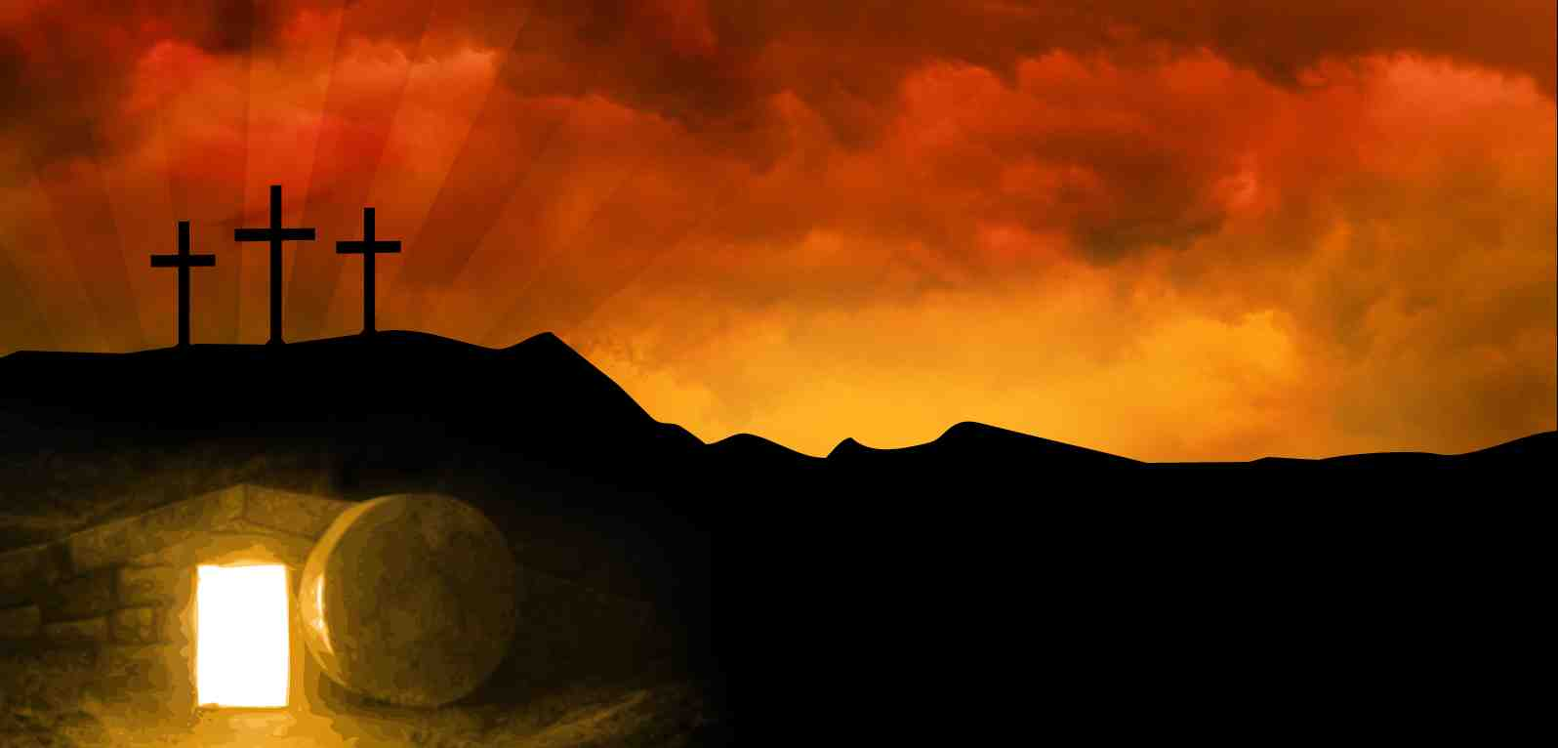
Risen and alive..
Acts 1:3 to whom He also presented Himself alive after His suffering by many infallible proofs, being seen by them during forty days and speaking of the things pertaining to the kingdom of God.

Slide 3
1 He appeared to the apostles..
Mark 16:11 And when they heard that He was alive and had been seen by her, they did not believe.
Acts 2:22-24 “Men of Israel, hear these words: Jesus of Nazareth.. whom God raised up, having loosed the pains of death, because it was not possible that He should be held by it.

Slide 4
2 Over a period of forty days..
Multiple appearances for an extended period, not just one isolated occasion..

Slide 5
He presented Himself alive by many infallible proofs..
3
“Tekmeriois”.. That which causes something to be known in a convincing and decisive manner..

Slide 6
What it means to us..
The proof of the resurrection.. abundant
The value of the resurrection.. He is Lord
The meaning of the resurrection.. He can conquer death

Slide 7
By Many Infallible Proofs
Acts 1:1-3

