Slide 1
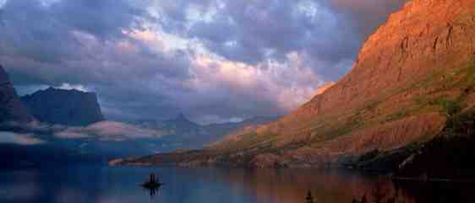
Comfort for a Troubled Heart
John 14:1-6

Slide 2
Troubled hearts..
Jesus was going away..
13:33 I shall be with you a little while longer..where I am going, you cannot come..
One of you will betray Me..
Peter will deny Me three times..

Slide 3
Jesus the true comforter
14:1 “Let not your heart be troubled..
At this time more concerned for His disciples..
13:1 having loved His own He loved them to the end
Assignment: not let our heart be troubled

Slide 4
1 Trust His Presence
1 “Let not your heart be troubled; you believe in God, believe also in Me..
Believe He is with us, just as God.
Leaving physically, but present spiritually.

Slide 5
Faith in God’s presence
Deut 31:6 Be strong and of good courage, do not fear nor be afraid of them; for the Lord your God, He is the One who goes with you. He will not leave you nor forsake you.”
Matt 28:20 I am with you always, even to the end of the age.”
Heb 13:5 For He Himself has said, “I will never leave you nor forsake you.”
1 Peter 1:8 whom having not seen you love. Though now you do not see Him, yet believing, you rejoice with joy inexpressible and full of glory.

Slide 6
2 Believe His Promises
2-3 In My Father’s house are many mansions; if it were not so, I would have told you. I go to pre-pare a place for you. ³ And if I go and prepare a place for you, I will come again and receive you to Myself; that where I am, there you may be also.
He is going to prepare a place for us
The Father’s house will be our home (Rev 21:16)
He wants us to be with Him (Rev 21:2-3; Jn 17:24)

Slide 7
3 Follow His Person
4-6 And where I go you know, and the way you know.” ⁵ Thomas said to Him, “Lord, we do not know where You are going, and how can we know the way?” ⁶ Jesus said to him, “I am the way, the truth, and the life. No one comes to the Father except through Me.
We don’t need to know how to get there
He will come back for us..

Slide 8
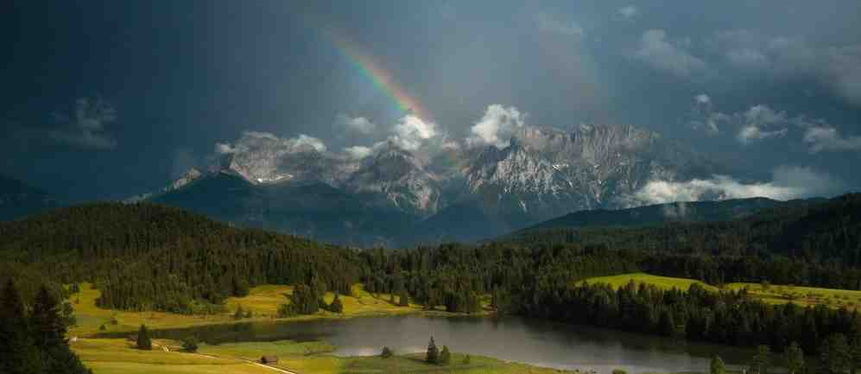
Comforting our hearts..
We can trust His Presence..
We can trust His Promises..
We can trust His Person..

Slide 9
Comfort for a Troubled Heart
John 14:1-6

