Slide 1
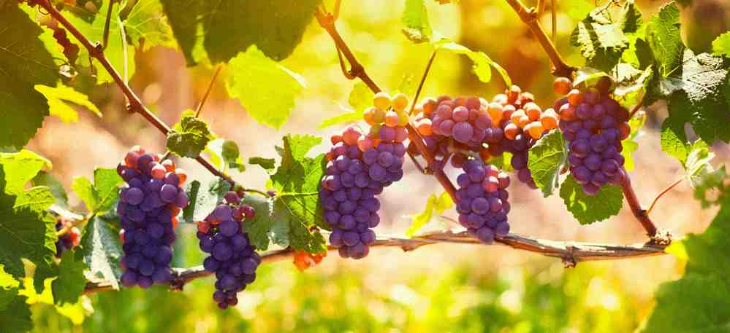
I am the True Vine
John 15:1-8

Slide 2
Why this metaphor?..
Immediate possibilities..
Symbolism of Old Testament..
The Lord’s Vineyard.. Psalm 80:8ff
Israel’s failure.. Isa 5:1-7; Jer. 2:21
I am the True Vine..
My Father the vinedresser..
You are the branches..

Slide 3
Message: Abide in the Vine..
Vs 4 Abide in Me, and I in you. As the branch cannot bear fruit of itself, unless it abides in the vine, neither can you, unless you abide in Me.
Requires action
What it looks like..

Slide 4
Promise: Bear godly fruit
Vs 5 “I am the vine, you are the branches. He who abides in Me, and I in him, bears much fruit; for without Me you can do nothing.
Abide in Me.. I in Him
What fruit?

Slide 5
Warning: Inspection..
Vs 6 If anyone does not abide in Me, he is cast out as a branch and is withered; and they gather them and throw them into the fire, and they are burned.
Danger of Becoming dead wood..
Productive branches are pruned..

Slide 6
Purpose: Glorify the Father
Vs 8 By this My Father is glorified, that you bear much fruit; so you will be My disciples.
Glorify the Father (not self)
Bearing fruit (mark of discipleship)

Slide 7
I am the True Vine
John 15:1-8

