Slide 1
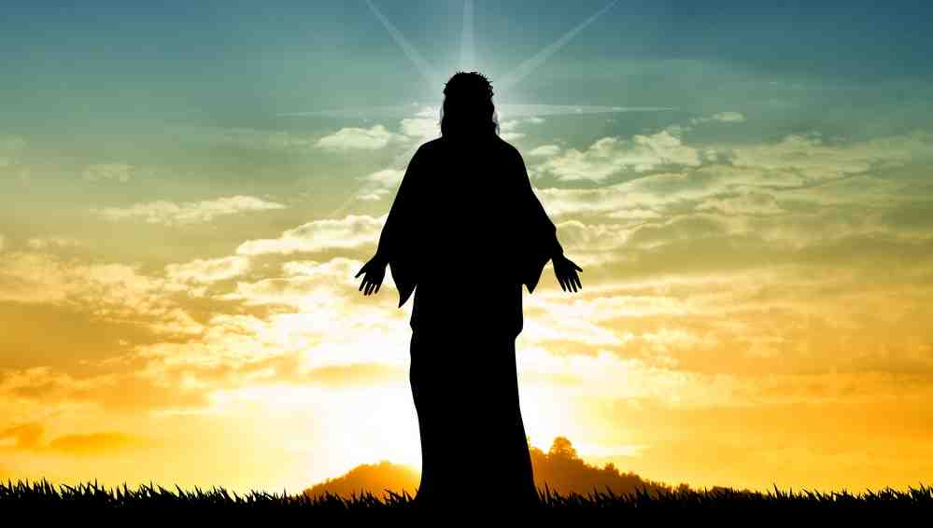
Show Us the Father
John 14:7-14

Slide 2
John 14:5-11..
The disciples still don’t quite understand..

Slide 3
Jesus is God incarnate..
John 1:1-3 In the beginning was the Word, and the Word was with God, and the Word was God. ² He was in the beginning with God. ³ All things were made through Him, and without Him nothing was made that was made.
1:14 the Word became flesh and dwelt among us, and we beheld His glory, the glory as of the only begotten of the Father, full of grace and truth.

Slide 4
1 His Person vs 7-11
(He is God.. )
⁷ “If you had known Me, you would have known My Father also; and from now on you know Him and have seen Him.”

Slide 5
1 His Person vs 7-11
(He is God.. )
⁸ Philip said to Him, “Lord, show us the Father, and it is sufficient for us.”
2 Cor 5:7 “We walk by faith, not by sight..”

Slide 6
1 His Person vs 7-11
(He is God.. )
⁹ Jesus said to him, “Have I been with you so long, and yet you have not known Me, Philip? He who has seen Me has seen the Father; so how can you say, ‘Show us the Father’?
Heb 1:3 who being the brightness of His glory and the express image of His person, and upholding all things by the word of His power, when He had by Himself purged our sins, sat down at the right hand of the Majesty on high

Slide 7
1 His Person vs 7-11
(He is God.. )
¹⁰ Do you not believe that I am in the Father, and the Father in Me? The words that I speak to you I do not speak on My own authority; but the Father who dwells in Me does the works.
¹¹ Believe Me that I am in the Father and the Father in Me, or else believe Me for the sake of the works themselves.

Slide 8
2 His Power vs 12
(You will do greater works)
¹² “Most assuredly, I say to you, he who believes in Me, the works that I do he will do also; and greater works than these he will do, because I go to My Father.

Slide 9
3 His Promise vs 13-14
(Ask in My name.. )
¹³ And whatever you ask in My name, that I will do, that the Father may be glorified in the Son. ¹⁴ If you ask anything in My name, I will do it.
Pray in His Person
Because of what Jesus has done
Pray for what Jesus would desire

Slide 10
Show Us the Father
John 14:7-14

