Slide 1
The Helper
John 14:15-26

Slide 2
Jesus’ comforting words..
Commandments.. what we are to do..
Promises.. what Christ has done for us..

Slide 3
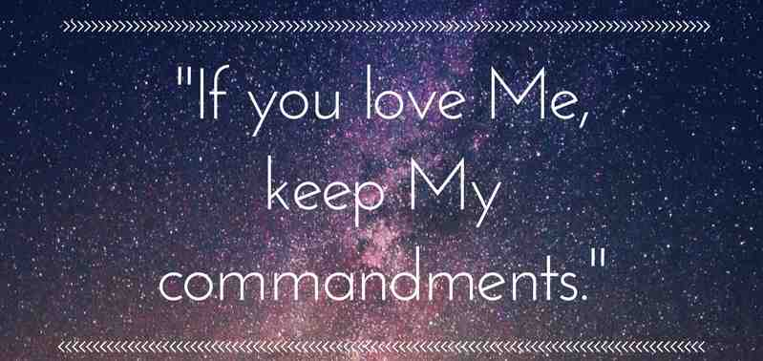
1 The Proof of our Love.. 15, 21, 23-24

Slide 4
2 Three promises to those who demonstrate their love
1) The Helper .. vs 15-27
2) Spiritual presence .. 18-24
3) Supernatural teacher .. 25-26

Slide 5
The Helper
John 14:15-26

