Slide 1
Beware of the Easy Way
Psalm 34:17-19

Slide 2
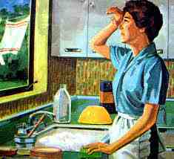
“Oh for the good old days”..
Modern conveniences make life easier..

Slide 3
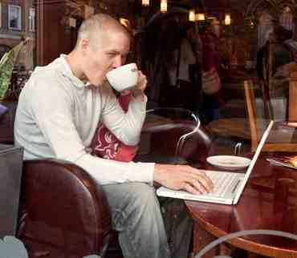
Life now in the digital age..
We expect our Christianity to be convenient..

Slide 4
The righteous cry out..
Psalm 34:17-19 The righteous cry out, and the Lord hears, and delivers them out of all their troubles. ¹⁸ The Lord is near to those who have a broken heart, and saves such as have a contrite spirit. ¹⁹ Many are the afflictions of the righteous, but the Lord delivers him out of them all.

Slide 5
Examples of the Easy Way
Lot chose the easy way.. Genesis 13:10-13
Abraham & Sarah helping God .. Gen 16:1-4
Moses chose the hard path.. Heb 11:24-26
David refused the easy choice.. 1 Sam 24:3-7
Satan offered Jesus the world.. Matt 4:8-10
Jesus chose the path of the cross.. Heb 5:8

Slide 6
The Purpose in Hardship
God’s ways are not like ours..
We are refined like gold.. 1 Pet 1:7-8
Trials develop godly qualities.. James 1:2-3
We are to follow Jesus’ example.. 1 Pet 2:21
Through patience we have hope.. Rom 5:3-5

Slide 7
Applying it to our life..
We cannot make the Christian life easier than God has appointed .. Acts 14:22
Applying diligence in our work.. Col 3:22
Don’t take the easy way in marriage and family.. Mark 10:9; Prov 23:13-14
Don’t settle for the easy way in salvation.. Heb 2:3

Slide 8
Beware of the Easy Way
Psalm 34:17-19

