Slide 1
Hope our Anchor of the Soul
Hebrews 6:9-20

Slide 2
We have an anchor..
Hebrews 6:19 This hope we have as an anchor of the soul, both sure and steadfast, and which enters the Presence behind the veil..

Slide 3
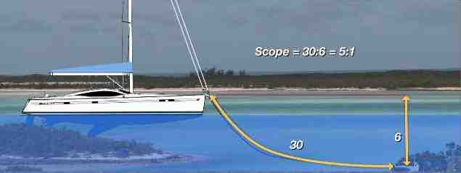
Anchors prevent drifting
HOPE

Slide 4
The Hebrew Christians needed Hope..
Hebrews 2:1 Therefore we must give the more earnest heed to the things we have heard, lest we drift away.
Heb 6:18 that by two immutable things, in which it is impossible for God to lie, we might have strong consolation, who have fled for refuge to lay hold of the hope set before us.

Slide 5
Hebrews 6:9-12 But, beloved, we are confident of better things concerning you, yes, things that accompany salvation,¹² that you do not become sluggish, but imitate those who through faith and patience inherit the promises.
Remember the refuge they found in Christ
Hold on to the hope they had found

Slide 6
We need this Hope..
Anyone “in Christ” can expect Salvation..
Romans 8:1 There is therefore now no condemnation to those who are in Christ Jesus, who do not walk according to the flesh, but according to the Spirit.
Are we distracted from this hope?
Are we growing and feeding our hope?

Slide 7
We cannot avoid storms..

Slide 8
The Focus of This Hope..
Hebrews 6:19 This hope we have as an anchor of the soul, both sure and steadfast, and which enters the Presence behind the veil..
Its Focus is on our Soul (Salvation)
God – 1 Tim 2:4; 2 Pet 3:9
Satan – John 8:44; 1 Pet 5:8
We can be anchored – Eph 4:14

Slide 9
Qualities of This Hope..
Hebrews 6:19 This hope we have as an anchor of the soul, both sure and steadfast, and which enters the Presence behind the veil..
Both sure and steadfast
God cannot lie.. Swore with an oath
Laid up in heaven .. Col 1:5

Slide 10
Assurance of This Hope..
Hebrews 6:19 This hope we have as an anchor of the soul, both sure and steadfast, and which enters the Presence behind the veil..
Jesus has entered the Veil
Heaven itself – Heb 9:1; 10:20

Slide 11
Hope our Anchor of the Soul
Hebrews 6:9-20

