Slide 1
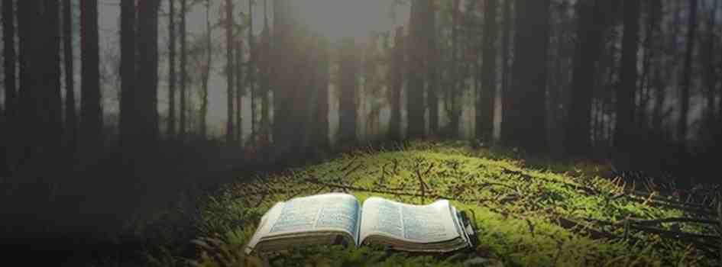
Knowing the All Knowing God
Psalm 139:1-7,13-16

Slide 2
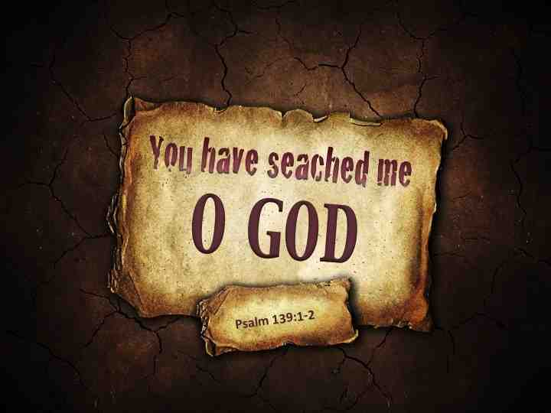
Psalm 139
O Lord, You have searched me and known me. ² You know my sitting down and my rising up.. Such knowledge is too wonderful for me; It is high, I cannot attain it.
⁷ Where can I go from Your Spirit? Or where can I flee from Your presence?
13 For You formed my inward parts; You covered me in my mother’s womb. ¹⁴ I will praise You, for I am fearfully and wonderfully made..

Slide 3
He invites us..
1 John 4:16 And we have known and believed the love that God has for us. God is love, and he who abides in love abides in God, and God in him.
Psalm 46:1 God is our refuge and strength, a very present help in trouble.

Slide 4
1 Our Greatest attainment ..
Jeremiah 9:23-24 Thus says the Lord.. “Let not the wise man glory in his wisdom, Let not the mighty man glory in his might, Nor let the rich man glory in his riches; ²⁴ But let him who glories glory in this, That he understands and knows Me, That I am the Lord, exercising lovingkindness, judgment, and righteousness in the earth. For in these I delight,” says the Lord.

Slide 5
Glory in this..
The right kind of bragging..
The right perspective..
Understanding His loyalty..
That I am the Lord, exercising lovingkindness, judgment, and righteousness in the earth. For in these I delight

Slide 6
2 Key to Eternal Life
John 17:2-3 “Father, the hour has come. Glorify Your Son, that Your Son also may glorify You, ² as You have given Him authority over all flesh, that He should give eternal life to as many as You have given Him. ³ And this is eternal life, that they may know You, the only true God, and Jesus Christ whom You have sent.

Slide 7
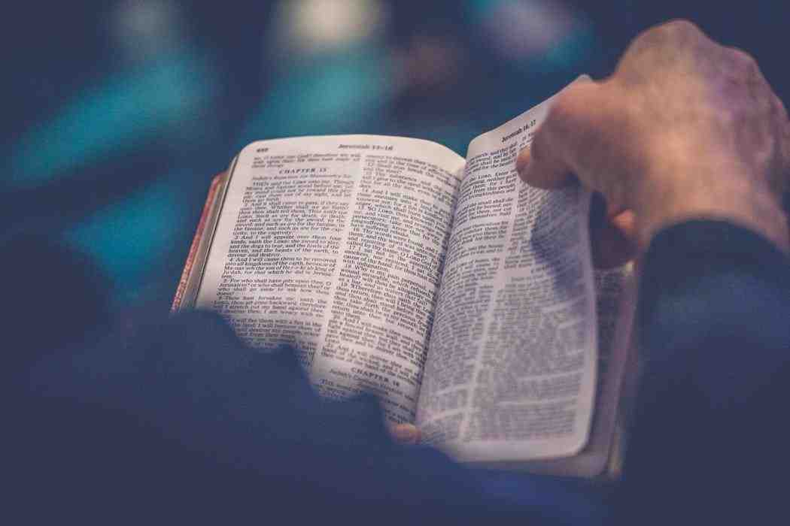
True authentic living..
God’s life lived out in us..
Sanctified in the truth (John 17:17)
Knowing God we know ourselves..

Slide 8
3 Responding in Real Life
Daniel 11:32 Those who do wickedly against the covenant he shall corrupt with flattery; but the people who know their God shall be strong, and carry out great exploits.
Knowing the right steps in bad situation

Slide 9
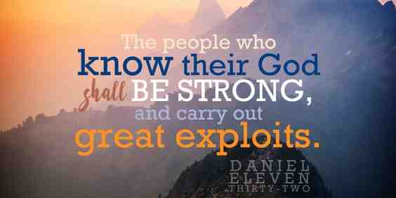

Slide 10
Strength to do right thing
Daniel 3:16-18 Shadrach, Meshach, and Abed-Nego answered..“O Nebuchadnezzar, we have no need to answer you in this matter. ¹⁷ If that is the case, our God whom we serve is able to deliver us from the burning fiery furnace, and He will deliver us from your hand, O king.
Confidence in God’s ability..

Slide 11
Wisdom
Ephesians 1:17-18 that the God of our Lord Jesus Christ, the Father of glory, may give to you the spirit of wisdom and revelation in the knowledge of Him..
Spiritual insight to apply to your life..

Slide 12
A Well Ordered Life
2 Peter 1:2-3 Grace and peace be multiplied to you in the knowledge of God and of Jesus our Lord, ³ as His divine power has given to us all things that pertain to life and godliness, through the true knowledge of Him who called us by glory and virtue..

Slide 13
4 Our Most challenging pursuit..
Romans 11:33-36 Oh, the depth of the riches both of the wisdom and knowledge of God! How unsearchable are His judgments and His ways past finding out!
Deut 4:29 you will seek the Lord your God, and you will find Him if you seek Him with all your heart and with all your soul.

Slide 14
Knowing the All Knowing God
Psalm 139:1-7,13-16

