Slide 1
How Important is Baptism?
Ephesians 4:1-6

Slide 2
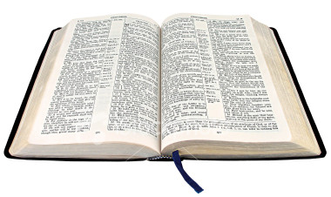
Important or not?..
Eph 4:1-6 endeavoring to keep the unity of the Spirit in the bond of peace. ⁴ There is one body and one Spirit..⁵ one Lord, one faith, one baptism; ⁶ one God and Father of all, who is above all, and through all, and in you all.
The Bible our only standard

Slide 3
Being able to answer..
1 Peter 3:15 But sanctify the Lord God in your hearts, and always be ready to give a defense to everyone who asks you a reason for the hope that is in you, with meekness and fear..
Eph 4:15 .. Speaking the truth in love..

Slide 4
Importance of truth..
A goal we all share in common..
John 8:31-32 “If you abide in My word, you are My disciples indeed. ³² And you shall know the truth, and the truth shall make you free.”
John 14:6 “I am the way, the truth, and the life”
John 17:17 “Sanctify them by Your truth. Your word is truth.”

Slide 5
Importance of truth..
Because so many answers are offered..
Necessary for salvation/Symbol already saved?
Complete immersion/Sprinkling or pouring?
Done with right purpose/Purpose doesn’t matter
Acts 17:11 Bereans searched scriptures whether these things were so..

Slide 6
Importance of love..
Many different ideas about baptism ..
Disagreements lead to arguments..
Very important.. Extremely sensitive..
If spoken unkindly, others will not listen..

Slide 7
Importance of love..
2 Tim 2:24-26 a servant of the Lord must not quarrel but be gentle to all, able to teach, patient, ²⁵ in humility correcting those who are in opposition, if God perhaps will grant them repentance, so that they may know the truth, ²⁶ and that they may come to their senses and escape the snare of the devil, having been taken captive by him to do his will.

Slide 8
Make it our goal..
Study .. Find out what the Bible says
Speak the truth.. with a spirit of love

Slide 9
How Important is Baptism?
Ephesians 4:1-6

