Slide 1
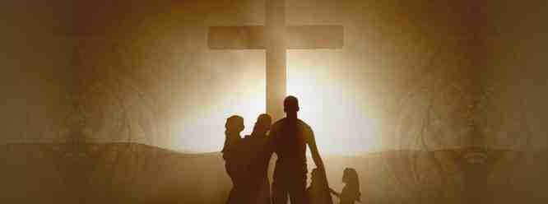
Minds Prepared to Worship
1 Peter 1:13-16

Slide 2
Enter carefully..
Eccl 5:1-2 Walk prudently when you go to the house of God; and draw near to hear rather than to give the sacrifice of fools, for they do not know that they do evil.
1 Peter 1:13 Therefore, preparing your minds for action, and being sober-minded, set your hope fully on the grace that will be brought to you at the revelation of Jesus Christ.

Slide 3
Preparing before the day
Exod 16:23 “This is what the Lord has said: ‘Tomorrow is a Sabbath rest, a holy Sabbath to the Lord. Bake what you will bake today, and boil what you will boil; and lay up for yourselves all that remains, to be kept until morning.’ ”
Exod 19:10-11 Then the Lord said to Moses, “Go to the people and consecrate them today and tomorrow, and let them wash their clothes. ¹¹ And let them be ready for the third day. For on the third day the Lord will come down upon Mount Sinai in the sight of all the people.

Slide 4
Levitical worship
Numbers 8:20-21 according to all that the Lord commanded Moses concerning the Levites, so the children of Israel did to them. ²¹ And the Levites purified themselves and washed their clothes; then Aaron presented them like a wave offering before the Lord, and Aaron made atonement for them to cleanse them.
Psalm 15:1-2 Lord, who may abide in Your tabernacle? Who may dwell in Your holy hill? ² He who walks uprightly,And works righteous-ness, And speaks the truth in his heart;

Slide 5
Jesus and His disciples
Mark 14:12-16 Now on the first day of Unleavened Bread, when they killed the Passover lamb, His disciples said to Him, “Where do You want us to go and prepare, that You may eat the Passover?” ¹³ And He sent out two of His disciples and said to them, “Go into the city, and a man will meet you carrying a pitcher of water; follow him.
¹⁶ So His disciples went out, and came into the city, and found it just as He had said to them; and they prepared the Passover.

Slide 6
When to start preparing..
1 Peter 1:13 Therefore, preparing your minds for action, and being sober-minded..
Psalm 1 Blessed is the man Who walks not in the counsel of the ungodly, Nor stands in the path of sinners, Nor sits in the seat of the scornful; ² But his delight is in the law of the Lord, And in His law he meditates day and night.

Slide 7
Noble minded Bereans..
Acts 17:11 These were more fair-minded than those in Thessalonica, in that they received the word with all readiness, and searched the Scriptures daily to find out whether these things were so.

Slide 8
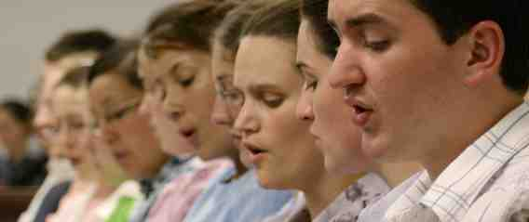
Profitable worship requires proper preparation
Preparing as spectators..
Preparing as workers..
Preparing to respond..
Preparing to edify..

Slide 9
Minds Prepared to Worship
1 Peter 1:13-16

