Slide 1
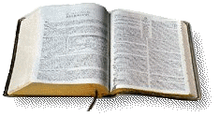
Saved by Faith (not) Only
James 2:17-24

Slide 2
Salvation by faith..
John 3:16 For God so loved the world that He gave His only begotten Son, that whoever believes in Him should not perish but have everlasting life.
Rom 1:16 For I am not ashamed of the gospel of Christ, for it is the power of God to salvation for everyone who believes..
Rom 5:1 having been justified by faith, we have peace with God through our Lord Jesus Christ..
Faith is essential to salvation

Slide 3
What the Bible also says
James 2:14-17 What does it profit, my brethren, if someone says he has faith but does not have works? Can faith save him?.. ¹⁷ Thus also faith by itself, if it does not have works, is dead.
2:21-24 Was not Abraham our father justified by works when he offered Isaac his son on the altar? ²³ And the Scripture was fulfilled which says, “Abraham believed God, and it was accounted to him for righteousness.”
2:24 You see then that a man is justified by works, and not by faith only..

Slide 4
All scripture is inspired..
Without doubt man is saved by faith..
But we are not justified by faith only..
Why do many insist we are saved by faith only?
Adding /subtracting from word of God (Rev 22:18)
Giving false assurance of salvation

Slide 5
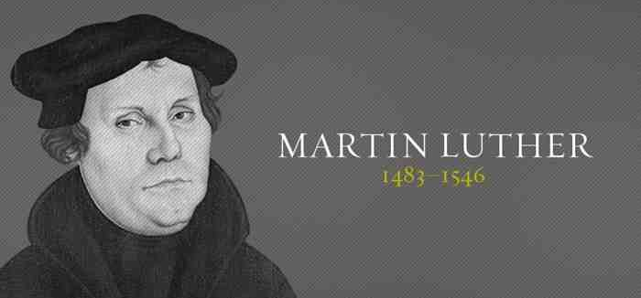
Faith only began with Luther..
Young monk in Germany spoke out against Roman Catholic abuses..
Led to Reformation.. Salvation by faith the key
In reacting to false doctrine, Luther created another.. added “only”
Rom 3:28 Therefore we conclude that a man is justified by faith apart from the deeds of the law.
Luther: “we reckon a man to be justified by faith alone (only) without deeds of law”
“St James’ epistle is really a right strawy epistle”

Slide 6
Misunderstanding of works
The works of God..
John 6:28 Then they said to Him, “What shall we do, that we may work the works of God?”²⁹ Jesus answered and said to them, “This is the work of God, that you believe in Him whom He sent.”
The works of men..
Eph 2:8-10 For by grace you have been saved through faith, and that not of yourselves; it is the gift of God, ⁹ not of works, lest anyone should boast. ¹⁰ For we are His workmanship, created in Christ Jesus for good works, which God prepared beforehand that we should walk in them.

Slide 7
Misunderstanding of works
The works (deeds) of the law..
Romans 4:1-3 What then shall we say that Abraham our father has found according to the flesh? ² For if Abraham was justified by works, he has something to boast about, but not before God. ³ For what does the Scripture say? “Abraham believed God, and it was accounted to him for righteousness.”
Rom 3:20 Therefore by the deeds of the law no flesh will be justified in His sight, for by the law is the knowledge of sin.

Slide 8
Saving Faith is obedient faith..
Faith without obedience..
John 12:42-43 Nevertheless even among the rulers many believed in Him, but because of the Pharisees they did not confess Him, lest they should be put out of the synagogue; ⁴³ for they loved the praise of men more than the praise of God.
Matt 10:32-33 “Therefore whoever confesses Me before men, him I will also confess before My Father who is in heaven. ³³ But whoever denies Me before men, him I will also deny before My Father who is in heaven.

Slide 9
Saving Faith is obedient faith..
The obedience of faith..
Rom 6:3-4 Or do you not know that as many of us as were baptized into Christ Jesus were baptized into His death? ⁴ Therefore we were buried with Him through baptism into death, that just as Christ was raised from the dead by the glory of the Father, even so we also should walk in newness of life.
6:17-18 But God be thanked that though you were slaves of sin, yet you obeyed from the heart that form of doctrine to which you were delivered. ¹⁸ And having been set free from sin, you became slaves of righteousness.

Slide 10
Saved by Faith (not) Only
James 2:17-24

