Slide 1
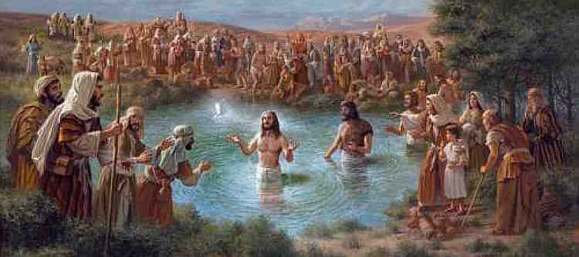
The Baptism of John
Mark 1:4-11

Slide 2
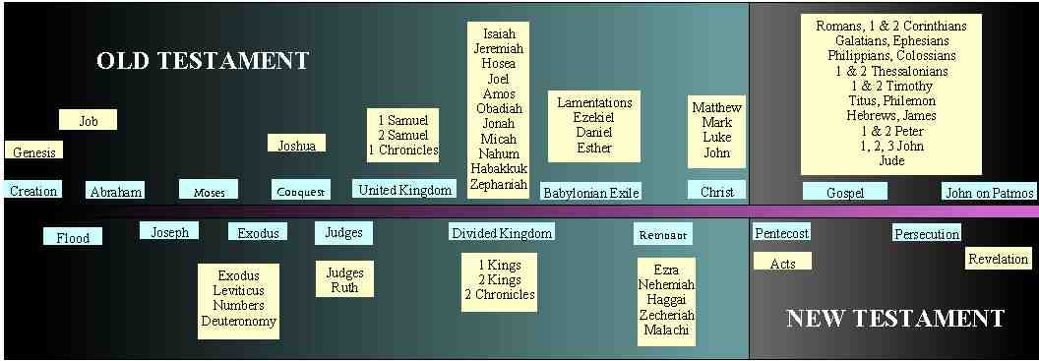
Baptism first appears in NT..
John was baptizing .. Mark 1:4,9-11
Jesus and his disciples baptizing.. John 3,4; Matthew 28:18-20
Day of Pentecost.. Acts 2:38,41
Book of Acts.. everywhere the gospel went
Epistles.. Rom 6:3-5; 1 Cor 12:13; Gal 3:27

Slide 3
The “What” of John’s baptism..
It involved water.. Mark 1:5, 8, 10
Literally..to dip, plunge, immerse .. Mark 1:4,8
Description as burial.. Rom 6:3-5, Col 2:12
There was much water.. John 3:23
Went down into water, came up from water.. Mark 1:10; Acts 8:38

Slide 4
What was required?
Repentance.. Mark 1:4
Confession of sin.. Matt 3:6
For the forgiveness of sins.. Mark 1:4
Prepared for the Lord.. Luke 1:17
By authority of God.. Matt 21:25

Slide 5
The “Why” of John’s baptism..
Why did John start baptizing people?
God told him to.. John 1:33; Luke 7:30
To point to Jesus.. Mark 1:2; Jn 1:31-33
To fulfill God’s purpose.. Matt 3:15; Luke 16:16

Slide 6
The end of John’s baptism..
It was not meant to last forever.. John 3:27-30
John’s death ended it.. Mark 6:14-29
Paul makes clear it ended.. Acts 19:1-5
Played important part in God’s plan.. Luke 3:7-14

Slide 7
John Came Baptizing
Mark 1:4-11

