Slide 1
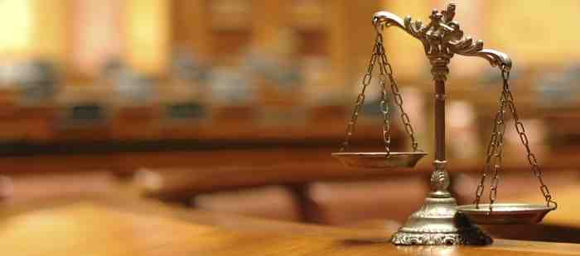
Jesus our Righteous Advocate
1 John 2:1-2

Slide 2
Sin a crime against God..
1 John 3:4 Whoever commits sin also commits lawlessness, and sin is lawlessness. (KJV sin is the transgression of the law).
Universal problem .. Rom 3:23
Punishment is severe .. Rom 6:23 James 1:15

Slide 3
John’s three part message..
Don’t sin v 1a “I am writing that you may not sin”
Don’t despair when you sin v 1b “but if anyone does sin we have an advocate with the Father”
He is the solution v 2

Slide 4
The Role of Advocate
“Advocate” (para – kletos)
“Called beside” called to one’s side
Used in court .. a legal assistant, counsel for the defense, advocate
5 times in NT (four refer to Holy Spirit)

Slide 5
Christ our Perfect Advocate ..
By virtue of His identity..
Jesus (salvation) Christ (Messiah)
Matt 1:21; 16:13-18; Luke 4:16-21
Righteous (upright, just, innocent)
Rom 3:10; Psa 14:1-4; Luke 23:47

Slide 6
Christ our Perfect Advocate ..
By virtue of His work..
Mediator (a middle person, reconciler)
1 Tim 2:5
Intercessor (pleading another’s cause)
Romans 8:34; Heb 7:25

Slide 7
John’s three part message..
Don’t sin v 1a “I am writing that you may not sin”
Don’t despair when you sin v 1b “but if anyone does sin we have an advocate with the Father”
He is the solution v 2

Slide 8
Christ our Perfect Advocate ..
Result: Jesus provides Atonement
1 John 2:2 He is the atoning sacrifice for our sins, and not only for ours but also for the sins of the world.
Hilasmos: expiation whereby sin is covered and remitted .. 1 John 4:10

Slide 9
Is Jesus Christ your Advocate?

Slide 10
Jesus our Righteous Advocate
1 John 2:1-2

