Slide 1
The Power of God’s Word
Hebrews 4:11-13

Slide 2
Living and powerful..
Hebrews 4:12 For the word of God is living and powerful, and sharper than any two-edged sword, piercing even to the division of soul and spirit, and of joints and marrow, and is a discerner of the thoughts and intents of the heart.

Slide 3
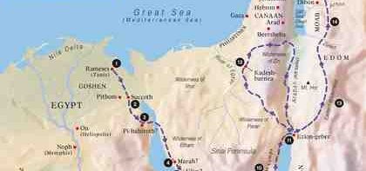
How to enter God’s rest..
4:1-2 Warning: don’t miss God’s rest..
Therefore, since a promise remains of entering His rest, let us fear lest any of you seem to have come short of it. ² For indeed the gospel was preached to us as well as to them; but the word which they heard did not profit them, not being mixed with faith in those who heard it.
3-5 We have entered God’s rest..
For we who have believed do enter that rest, as He has said:“So I swore in My wrath, ‘They shall not enter My rest,’ ” although the works were finished from the foundation of the world. ⁴ For He has spoken in a certain place of the seventh day in this way: “And God rested on the seventh day from all His works”; ⁵ and again in this place: “They shall not enter My rest.”

Slide 4
How to enter God’s rest..
6-9 A rest remains for the people of God..
⁶ Since therefore it remains that some must enter it, and those to whom it was first preached did not enter because of disobedience, ⁷ again He designates a certain day, saying in David, “Today,” after such a long time, as it has been said: “Today, if you will hear His voice, Do not harden your hearts.”
⁸ For if Joshua had given them rest, then He would not afterward have spoken of another day. ⁹ There remains therefore a rest for the people of God. ¹⁰ For he who has entered His rest has himself also ceased from his works as God did from His.

Slide 5
The word reveals our condition..
11-13 Let us therefore be diligent to enter that rest, lest anyone fall according to the same example of disobedience.
¹² For the word of God is living and powerful, and sharper than any two-edged sword, piercing even to the division of soul and spirit, and of joints and marrow, and is a discerner of the thoughts and intents of the heart.
¹³ And there is no creature hidden from His sight, but all things are naked and open to the eyes of Him to whom we must give account.

Slide 6
The power of God’s word..
God’s word is living..
God’s word is active..
God’s word is sharp and piercing..
Nothing is hidden ..

Slide 7
The Power of God’s Word
Hebrews 4:11-13

