Slide 1
Abounding in the Work of the Lord
1 Corinthians 15:54-58

Slide 2
The Lord’s work..
⁵⁶ The sting of death is sin, and the strength of sin is the law. ⁵⁷ But thanks be to God, who gives us the victory through our Lord Jesus Christ.
⁵⁸ Therefore, my beloved brethren, be steadfast, immovable, always abounding in the work of the Lord, knowing that your labor is not in vain in the Lord.

Slide 3
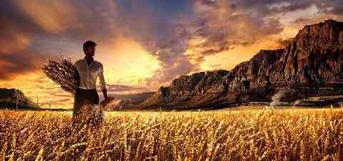
The nature of His work..
The Gospel (evangelism).. Mark 16:15-16
Building ourselves up (edification).. Eph 4:12
Helping needy saints (benevolence).. 2 Cor 8-9
Being an active member of the body.. Rom 12

Slide 4
Laborers needed..
Matt 9:36-39 But when He saw the multitudes, He was moved with compassion for them, because they were weary and scattered, like sheep having no shepherd. ³⁷ Then He said to His disciples, “The harvest truly is plentiful, but the laborers are few. ³⁸ Therefore pray the Lord of the harvest to send out laborers into His harvest.”

Slide 5
Pray the Lord for help

Slide 6
1 Motives for the work..
The final resurrection.. “Therefore..”
Proof of Jesus’ resurrection v 1-12
If there is no resurrection v 14-19
We will receive a new body 35-49
The final judgment.. “your labor is not in vain”
A day of accounting, a day of reward.. Gal 6:9

Slide 7
2 The work is for all..
My beloved brethren.. All Christians
Not elders, deacons only 1 Timothy 3:1-13
Every Christian’s talents Matt 25:14; Rom 12:4-6
Paul, Timothy, Eunice, Dorcas, Barnabas..

Slide 8
3 The basic requirement..
Conviction .. Be steadfast, unmovable
Firm in faith and commitment.. Heb 10:39
Work of faith, labor of love.. 1 Thess 1:3; James 2

Slide 9
3 The basic requirement..
Conviction .. Be steadfast, unmovable
Hindered by lack of knowledge, doubt 1 Cor 8-14
Firm in faith and commitment.. Heb 10:39
Work of faith, labor of love.. 1 Thess 1:3; James 2

Slide 10
4 Constancy of the work..
Always abounding..
Living for Christ all the time.. Col 4:6;Phil 4:4
Abounding (perisseuo = to excel, over and above)
Willing service.. Matt 20:7-16

Slide 11
Abounding in the Work of the Lord
1 Corinthians 15:54-58

