Slide 1
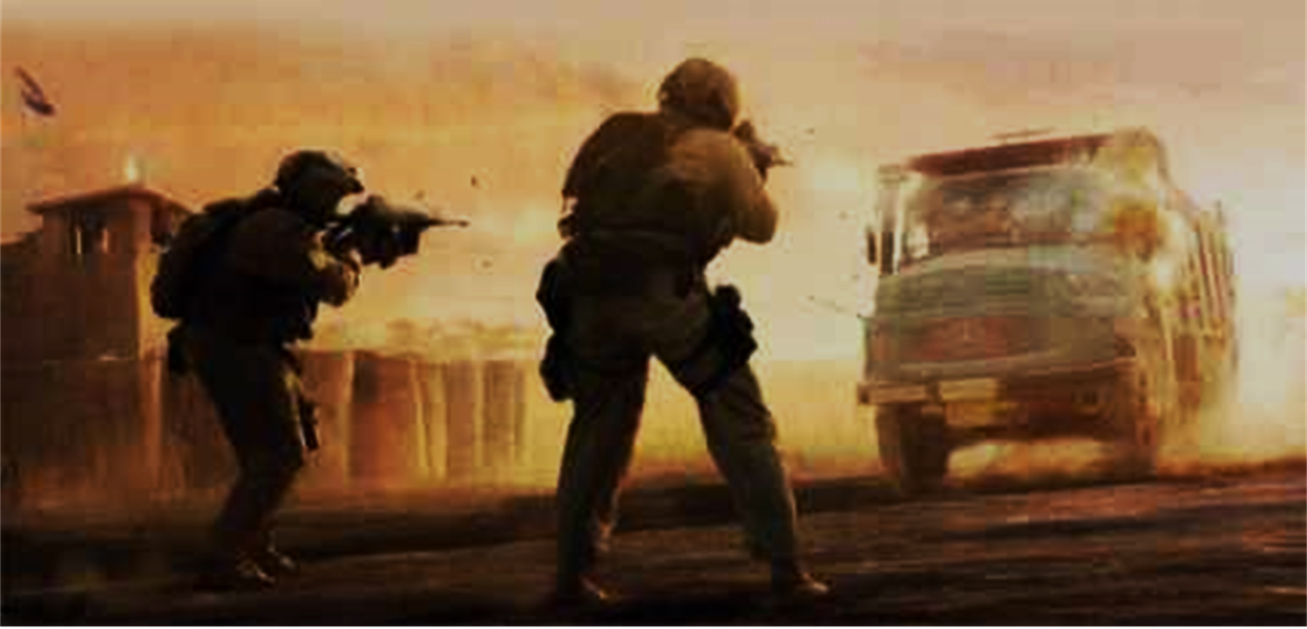
They Did Their Duty into Eternity
Hebrews 10:34-39

Slide 2
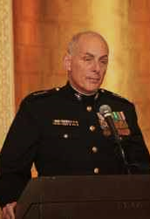
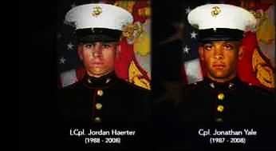
Ramadi, Iraq - 2008
Lt Gen John Kelly
Corp Jordan Haerter
Corp Jonathan Yale
“Six seconds to live”

Slide 3
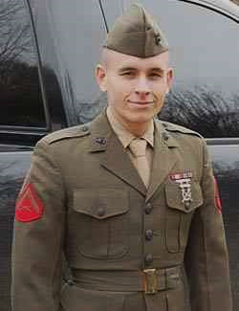
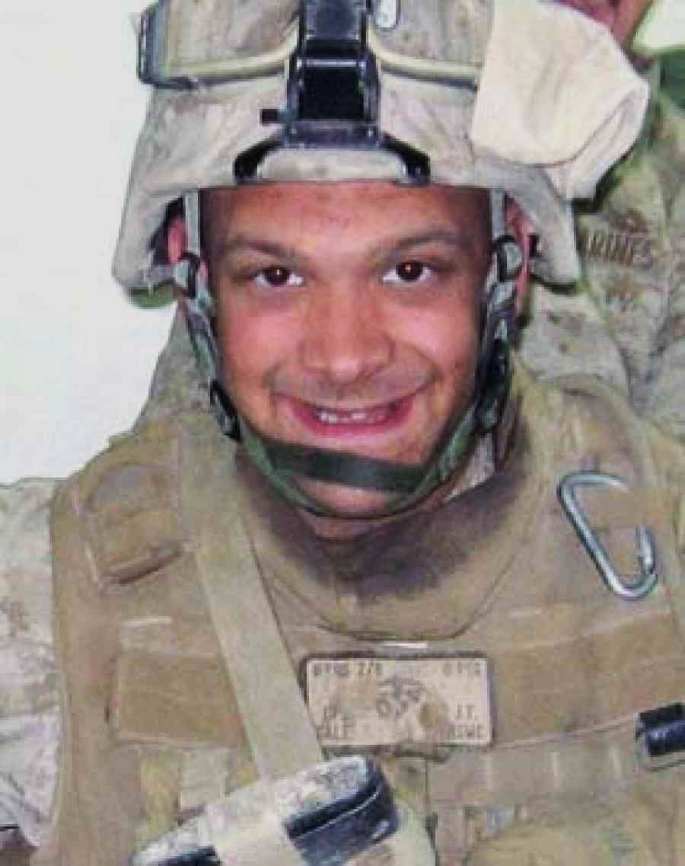
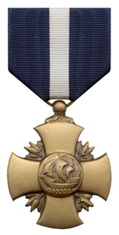
Corp Jordan Haerter
20, Long Island NY
Corp Jonathan Yale
22, Virginia

Slide 4
Two of America’s finest.. On watch for you
Stood their ground
Used their weapons
Did their duty into eternity

Slide 5
The Hebrew saints..
Heb 10:34-39 But recall the former days in which, after you were illuminated, you endured a great struggle with sufferings: ³³ partly while you were made a spectacle both by reproaches and tribulations, and partly while you became companions of those who were so treated; ³⁴ for you had compassion on me in my chains, and joyfully accepted the plundering of your goods, knowing that you have a better and an enduring possession for yourselves in heaven..

Slide 6
Need of endurance..
³⁵ Therefore do not cast away your confidence, which has great reward ³⁶ For you have need of endurance, so that after you have done the will of God, you may receive the promise: ³⁷ “For yet a little while, And He who is coming will come and will not tarry. ³⁸ Now the just shall live by faith; but if anyone draws back, My soul has no pleasure in him.” ³⁹ But we are not of those who draw back to perdition, but of those who believe to the saving of the soul.

Slide 7
Stand firm in the Lord
Phil 4:1 Therefore, my brothers, whom I love and long for, my joy and crown, stand firm thus in the Lord, my beloved.
Exodus 14:1-14 Do not be afraid. Stand still, and see the salvation of the Lord which He will accomplish for you today.
Isaiah 46:5-11 Remember the former things of old. For I am God, and there is none like Me.
Phil 1:27 Only let your manner of life be worthy of the gospel of Christ, so that whether I come and see you or am absent, I may hear of you that you are standing firm in one spirit, with one mind striving side by side for the faith of the gospel..

Slide 8
Knowledge to use our weapons
2 Cor 10:3-4 For though we walk in the flesh, we are not waging war according to the flesh. ⁴ For the weapons of our warfare are not of the flesh but have divine power to destroy strongholds.
Eph 6:16-17 In all circumstances take up the shield of faith, with which you can extinguish all the flaming darts of the evil one; ¹⁷ and take the helmet of salvation, and the sword of the Spirit, which is the word of God..
1 Peter 3:15 But sanctifythe Lord God in your hearts, and always be ready to give a defense to everyone who asks you a reason for the hope that is in you, with meekness and fear;

Slide 9
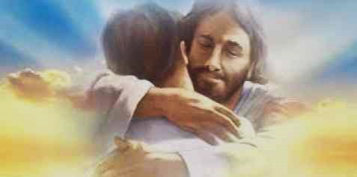
Faithful until death
Rev 2:10 Do not fear any of those things which you are about to suffer. Indeed, the devil is about to throw some of you into prison, that you may be tested, and you will have tribulation ten days. Be faithful until death, and I will give you the crown of life.
2 Tim 2:3-4 You therefore must endure hardship as a good soldier of Jesus Christ. ⁴ No one engaged in warfare entangles himself with the affairs of this life, that he may please him who enlisted him as a soldier.
Rev 21:7 He who overcomesshall inherit all things, and I will be his God and he shall be My son.

Slide 10
Summary of our lives..
We stood our ground..
We used our (spiritual) weapons..
We did our duty (into eternity)..
Heb 10:39 But we are not of those who draw back to perdition, but of those who believe to the saving of the soul.

Slide 11
They Did Their Duty into Eternity
Hebrews 10:34-39

