Slide 1
The Romans Road
Romans 1:16-17

Slide 2
The Romans Road has a starting and finishing line
Starting point..
Romans 1:16-17 For I am not ashamed of the gospel of Christ, for it is the power of God to salvation for everyone who believes, for the Jew first and also for the Greek.
The Gospel can save any person..

Slide 3
It begins with an idea and ends with an assurance..
Finishing line..
Romans 8:37-39 For I am persuaded that neither death nor life, nor angels nor principalities nor powers, nor things present nor things to come, ³⁹ nor height nor depth, nor any other created thing, shall be able to separate us from the love of God which is in Christ Jesus our Lord.
Overwhelming assurance of rich and loving relationship with God

Slide 4
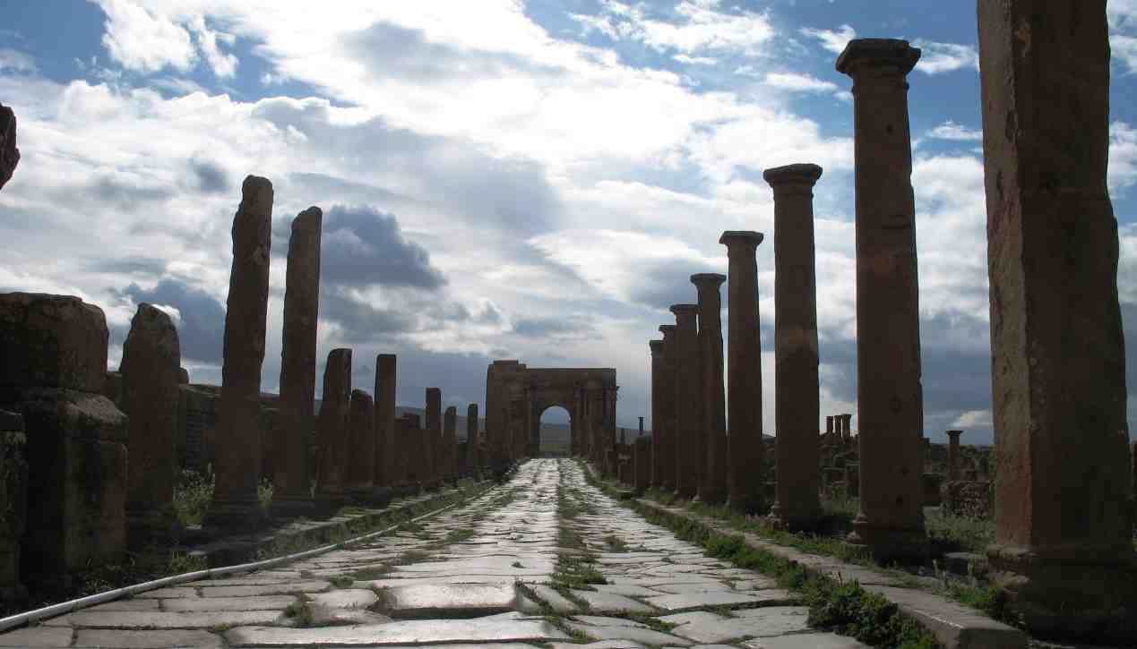
Mile 1.. The World’s Sin
Rom 1:18-23 For the wrath of God is revealed from heaven against all ungodliness and unrighteousness of men, who suppress the truth in unrighteousness, ¹⁹ because what may be known of God is manifest in them, for God has shown it to them. ²⁰ For since the creation of the world His invisible attributes are clearly seen, being understood by the things that are made, even His eternal power and Godhead, so that they are without excuse..
Observe sin in the world and know there is no excuse

Slide 5
Mile 2.. You also sin..
Rom 2:1-4 Therefore you are inexcusable, O man, whoever you are who judge, for in whatever you judge another you condemn yourself; for you who judge practice the same things.. ³ And do you think this, O man, you who judge those practicing such things, and doing the same, that you will escape the judgment of God? ⁴ Or do you despise the riches of His goodness, forbearance, and longsuffering, not knowing that the goodness of God leads you to repentance?
The religious also sin..

Slide 6
Mile 3.. None of us are righteous..
Rom 3:9-11 What then? Are we better than they? Not at all. For we have previously charged both Jews and Greeks that they are all under sin.¹⁰ As it is written: “There is none righteous, no, not one; ¹¹ There is none who understands; There is none who seeks after God.
We will always have sin in our lives.. None will be righteous unless God makes you righteous

Slide 7
Mile 4.. God can make us righteous
Rom 4:1-3 What then shall we say that Abraham our father has found according to the flesh? ² For if Abraham was justified by works, he has something to boast about, but not before God. ³ For what does the Scripture say? “Abraham believed God, and it was accounted to him for righteousness.”
How one man found righteousness in one way.. by putting all His trust in God

Slide 8
Mile 5.. You can be made righteous only by Christ..
Rom 5:1-2 Therefore, having been justified by faith, we have peace with God through our Lord Jesus Christ, ² through whom also we have access by faith into this grace in which we stand, and rejoice in hope of the glory of God.
Understand the only thing that will make me righteous is the blood of Christ..

Slide 9
The Romans Road
Romans 1:16-17

