Slide 1
The Romans Road
Romans 8:1-5

Slide 2
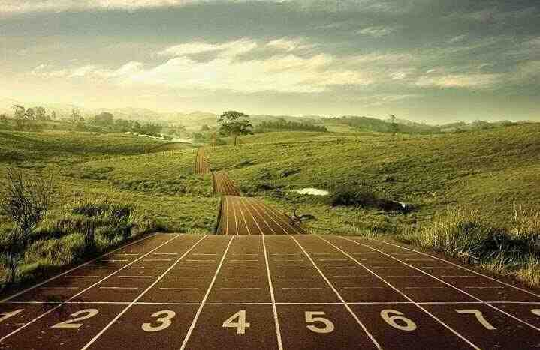
The Starting line..
Romans 1:16-17 the Gospel can save anyone who believes the whole message..

Slide 3
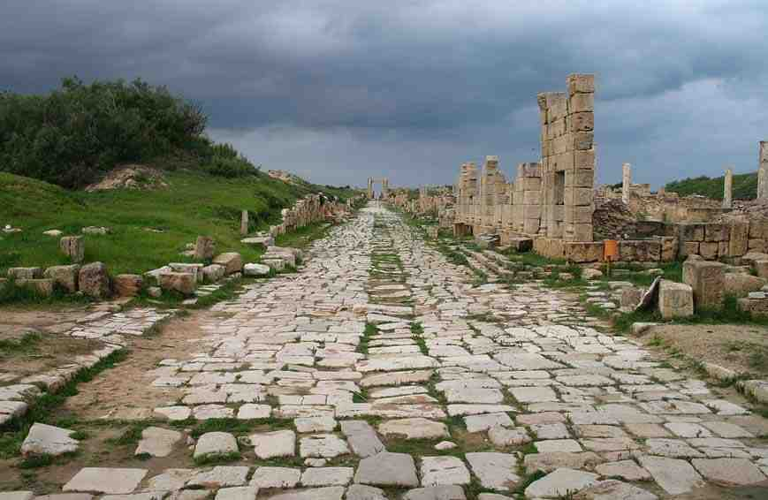
The first 5 miles..
Mile 1 Rom 1:18-23 the world is living in sin (because God’s existence is clearly revealed)
Mile 2 Rom 2:1-4 we have no right to judge them because we also have sinned..
Mile 3 Rom 3:9-23 None of us are righteous.. (but God is.. and He can make us righteous)
Mile 4 Rom 4:1-8 How Abraham found righteousness (by total trust in God)
Mile 5 Rom 5:1-11 We need faith in Jesus.. (believe you can be made righteous by Him alone)

Slide 4
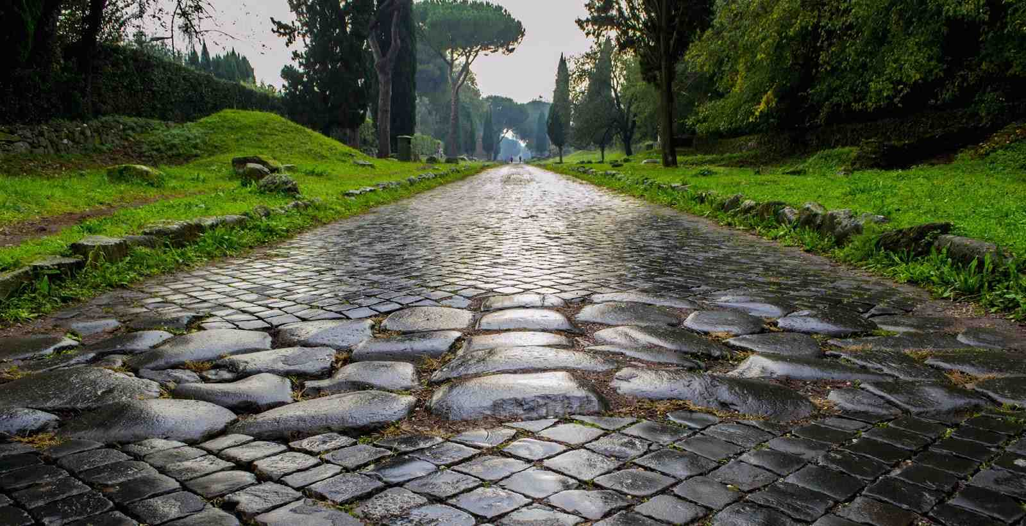
Mile 6.. We must die with Christ
6:1-7 We must die with Him in baptism..
6:11-13 Baptism is commitment to live a new life
6:16-23 We must live as slaves to Him.. so we can realize the benefits

Slide 5
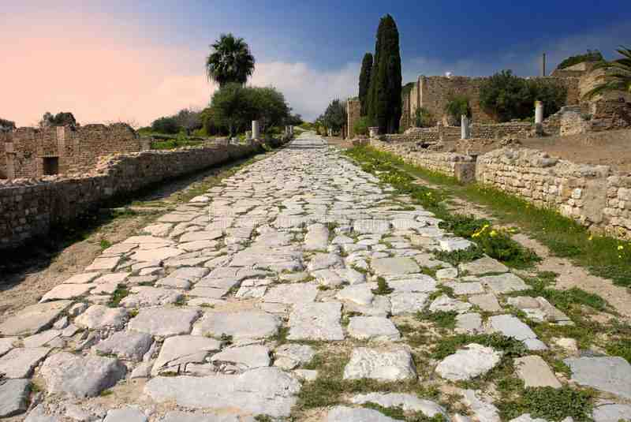
Mile 7 Find peace only in Jesus..
7:1-6 The death of Christ freed from the old law so we can be joined to Christ..
7:7-13 Paul’s own life under the old law
7:14-24 What was life like for a good man trying to follow a good law.. The problem was Sin
7:25 Sin will always be a fight.. But we can win with the help only Jesus provides

Slide 6
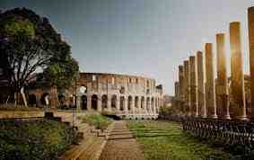
Mile 8 The Holy Spirit sustains us..
8:1-8 Assurance in Christ.. Set your mind and life daily on the Holy Spirit’s will..
8:12-14 Choose to be led by the Spirit..
8:22-30 Daily duties.. Amazing assurances
8:38-39 Finish line: a relationship in God’s love which no one can take from you

Slide 7
The Romans Road
Romans 8:1-5

