Slide 1
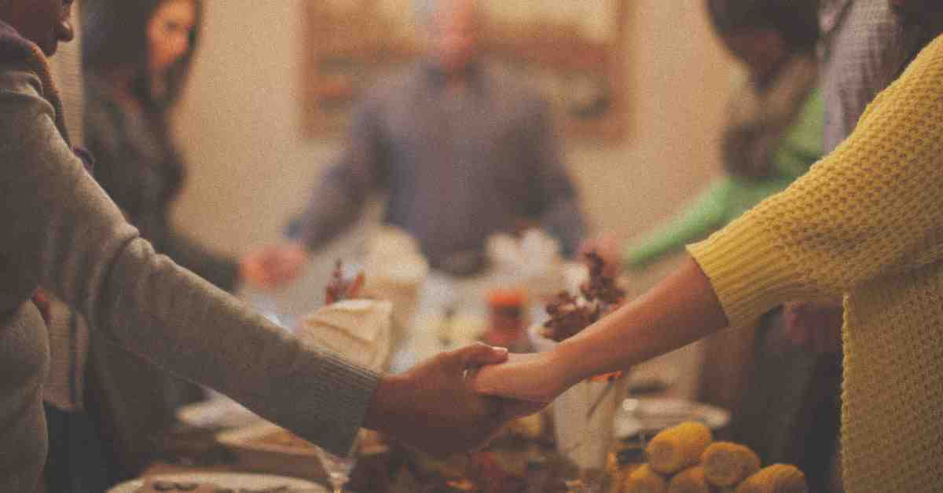
God’s Gift of Gratitude
Ephesians 5:1-6

Slide 2
God teaches us to be thankful in all things..
1 Thessalonians 5:18 in everything give thanks; for this is the will of God in Christ Jesus for you.

Slide 3
Thanksgiving is necessary for Christians (coveting is death)..
OT background.. bondage in Egypt
Exodus 20:1-3 “I am the Lord your God, who brought you out of the land of Egypt, out of the house of bondage. ³ “You shall have no other gods before Me.
¹⁷ “You shall not covet your neighbor’s house; you shall not covet your neighbor’s wife, nor his male servant, nor his female servant, nor his ox, nor his donkey, nor anything that is your neighbor’s.”

Slide 4
Thanksgiving is necessary for Christians (coveting is death)..
NT.. God’s gift of His Son
Eph 1:3-14 ³ Blessed be the God and Father of our Lord Jesus Christ, who has blessed us with every spiritual blessing in the heavenly places in Christ,
5:3-6 But fornication and all uncleanness or covetousness, let it not even be named among you, as is fitting for saints; ⁴ neither filthiness, nor foolish talking, nor coarse jesting, which are not fitting, but rather giving of thanks. ⁵ For this you know, that no fornicator, unclean person, nor covetous man, who is an idolater, has any inheritance in the kingdom of Christ and God.

Slide 5
God’s creation requires gratitude in order for us to avoid sin..
Rom 1:20-21 For since the creation of the world His invisible attributes are clearly seen.. because, although they knew God, they did not glorify Him as God, nor were thankful, but became futile in their thoughts, and their foolish hearts were darkened.
26-28 For this reason God gave them up to vile passions. ²⁸ as they did not like to retain God in their knowledge, God gave them over to a debased mind, to do those things which are not fitting;

Slide 6
God’s redemption requires gratitude in order for us to avoid sin..
Col 1:12-23 giving thanks to the Father who has qualified us to be partakers of the inheritance of the saints in the light. ¹³ He has delivered us from the power of darkness and conveyed us into the kingdom of the Son of His love,
5 Therefore put to death your members which are on the earth: fornication, uncleanness, passion, evil desire, and covetousness, which is idolatry. ⁶ Because of these things the wrath of God is coming upon the sons of disobedience,

Slide 7
Jesus by example was thankful at the last supper..
Matt 26:26-28 And as they were eating, Jesus took bread, blessed and broke it, and gave it to the disciples and said, “Take, eat; this is My body.”²⁷ Then He took the cup, and gave thanks, and gave it to them, saying, “Drink from it, all of you. ²⁸ For this is My blood of the new covenant, which is shed for many for the remission of sins.

Slide 8
God’s Gift of Gratitude
Ephesians 5:1-6

