Slide 1
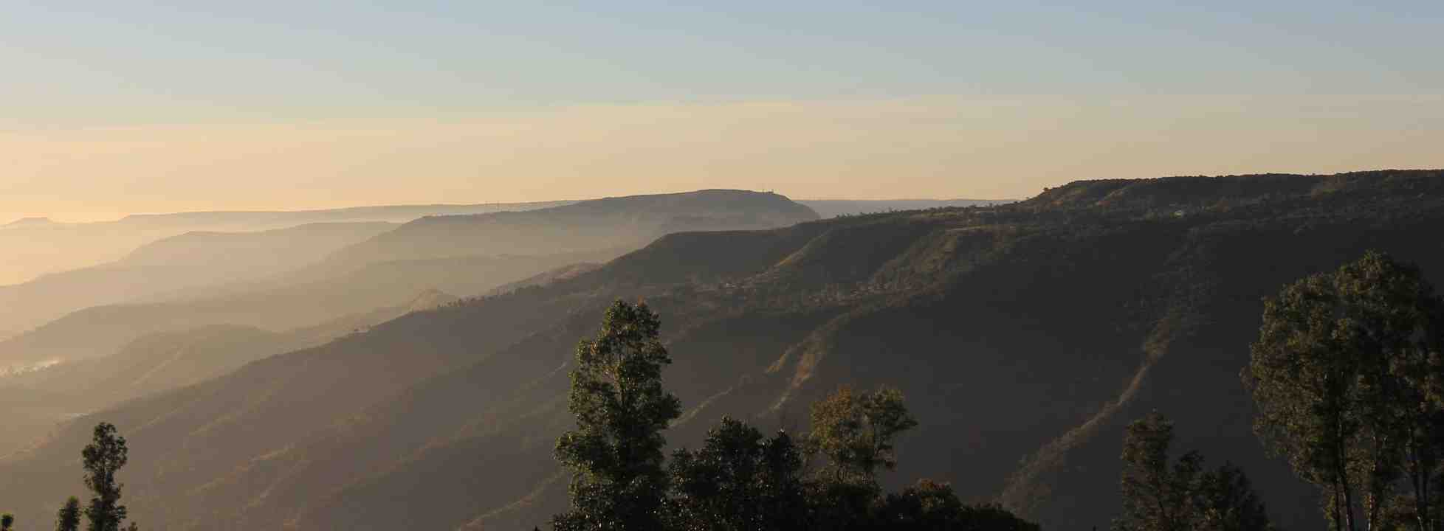
Great is God’s Faithfulness
Lamentations 3:21-24

Slide 2
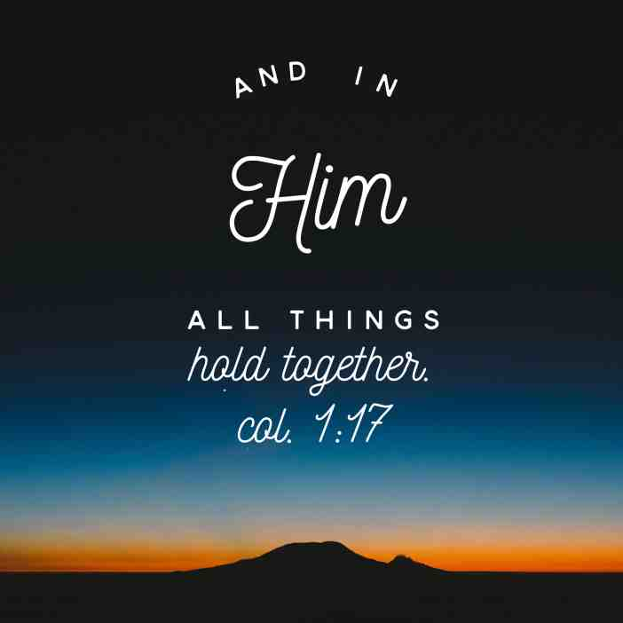

Slide 3
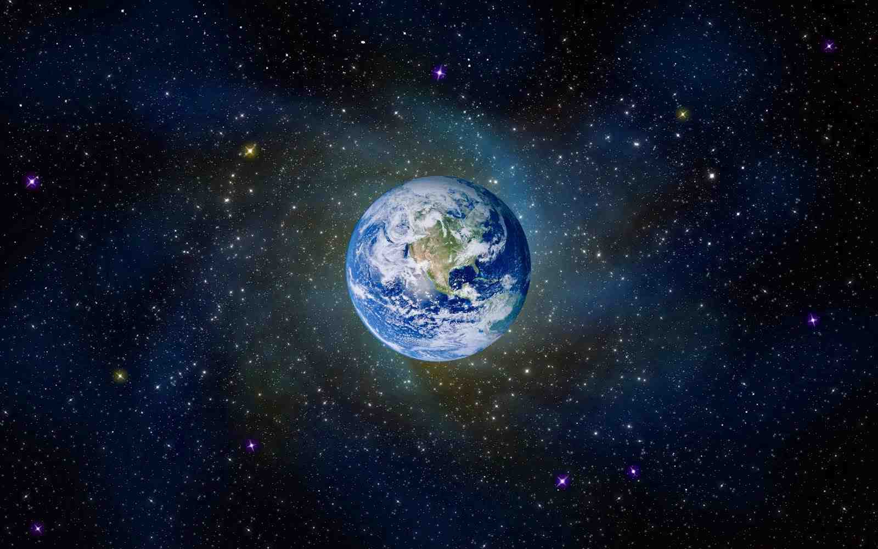
Your faithfulness You shall establish in the very heavens
- Psalm 89:2
Gen 8:22-23 “While the earth remains, Seedtime and harvest, Cold and heat, Winter and summer, And day and night, Shall not cease.”

Slide 4
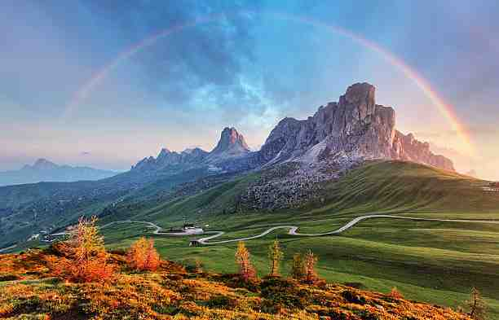
Psalm 89:2 Your faithfulness endures to all generations. You established the earth and it abides.
“His compassions fail not. ²³ They are new every morning; Great is Your faithfulness.”
Lamentations 3:22-23

Slide 5
God’s Faithfulness in your life..
Freedom from worry.. Heb 10:23
Assurance of answered prayer.. Psalm 143:1
Protects us from evil.. 2 Thess 3:3
2 Tim 2:13 ‘If we are faithless, He remains faithful; He cannot deny Himself ’
Produces praise.. Psa 89:1-8; 92:1-2

Slide 6
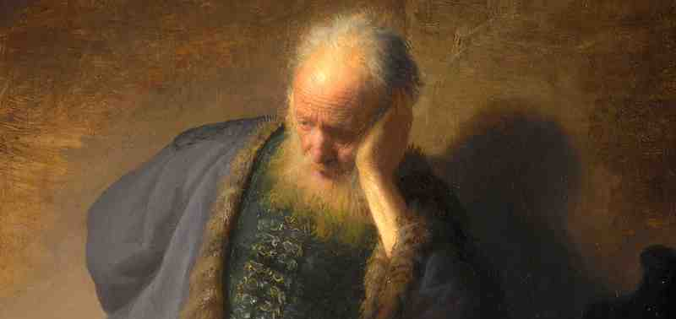
God’s Faithfulness provides Encouragement..
Lamentations 3:21-24 This I recall to my mind, Therefore I have hope. ²² Through the Lord’s mercies we are not consumed, Because His compassions fail not. ²³ They are new every morning; Great is Your faithfulness.

Slide 7
Great is God’s Faithfulness
Lamentations 3:21-24

Slide 8
Great is God’s Faithfulness
Lamentations 3:21-24

