Slide 1
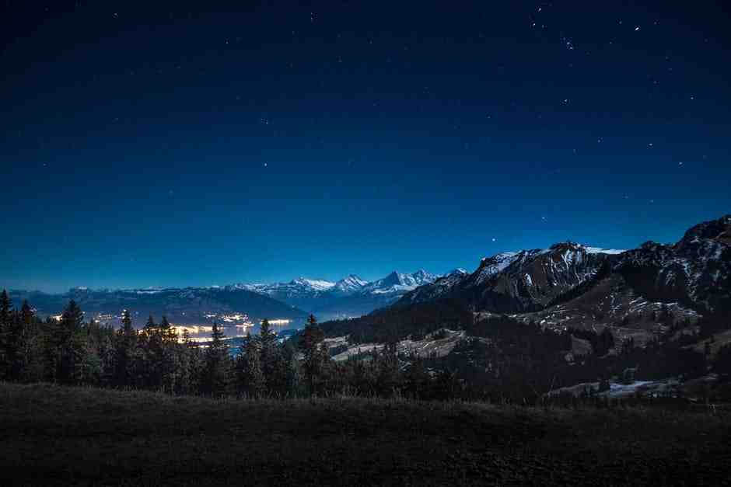
Seeking God
Acts 17:24-28

Slide 2
God is the ultimate giver..
James 1:17 Every good gift and every perfect gift is from above, and comes down from the Father of lights, with whom there is no variation or shadow of turning.

Slide 3
1 God plans for you to seek Him..
Acts 17:26-27 He has made from one blood every nation of men to dwell on all the face of the earth..²⁷ so that they should seek the Lord, in the hope that they might grope for Him and find Him, though He is not far from each one of us..

Slide 4
1 God plans for you to seek Him..
Major theme of the Bible..
1 Chron 22:19.. set your heart to seek the Lord
Prov 8:19.. those who seek Me will find Me
Jer 29:13 .. You will seek Me and find Me..
Psalm 34:10.. those who seek the Lord

Slide 5
2 Seeking God requires our effort..
Hebrews 11:6 But without faith it is impos-sible to please Him, for he who comes to God must believe that He is, and that He is a rewarder of those who diligently seek Him.
James 2:19-20 You believe that there is one God. You do well. Even the demons believe—and tremble! ²⁰ But do you want to know, O foolish man, that faith without works is dead?

Slide 7
2 Seeking God requires our effort..
Deuteronomy 4:29 But from there you will seek the Lord your God, and you will find Him if you seek Him with all your heart and with all your soul.
Jeremiah 29:13 And you will seek Me and find Me, when you search for Me with all your heart.

Slide 8
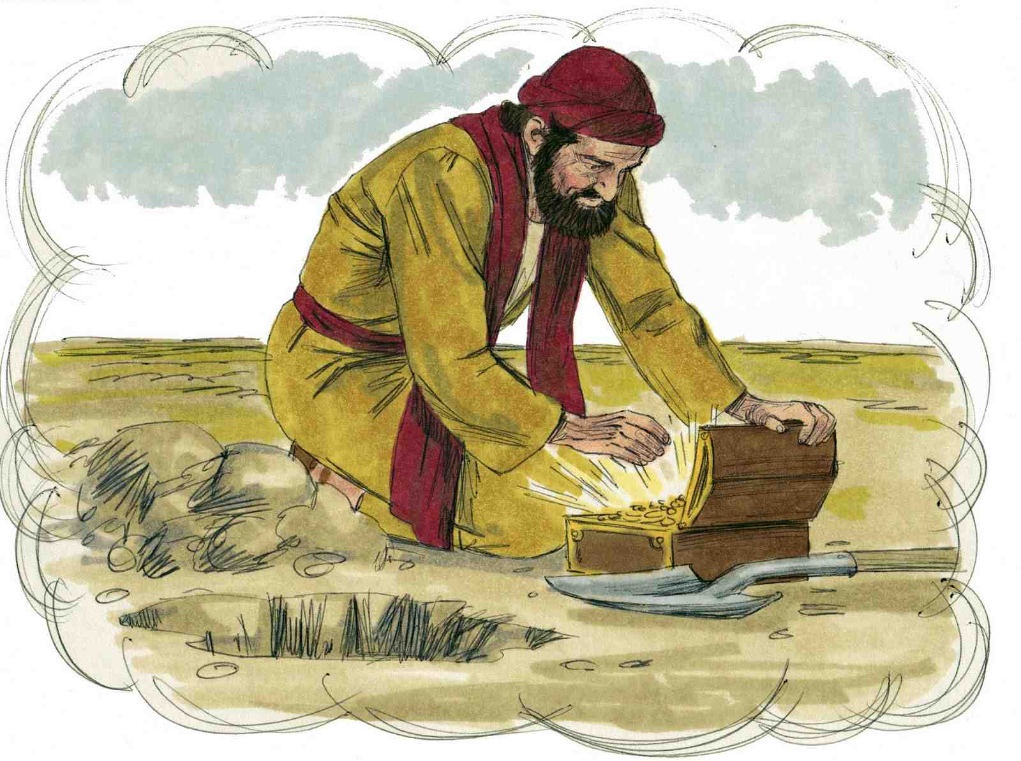
Matthew 13:44-46

Slide 9
3 We will find Him if we seek truly..
Psalm 9:10 And those who know Your name will put their trust in You; For You, Lord, have not forsaken those who seek You.
Matt 7:7-8 “Ask, and it will be given to you; seek, and you will find; knock, and it will be opened to you. ⁸ For everyone who asks receives, and he who seeks finds, and to him who knocks it will be opened.

Slide 10
3 We will find Him if we seek truly..
1 Chron 28:9 serve Him with a loyal heart and with a willing mind; for the Lord searches all hearts and understands all the intent of the thoughts. If you seek Him, He will be found by you; but if you forsake Him, He will cast you off forever.
Psalm 119:2, 10-12 Blessed are those who keep His testimonies, who seek Him with the whole heart!.. Blessed are those who keep His testi-monies, who seek Him with the whole heart!

Slide 12
Seeking God
Acts 17:24-28

