Slide 1
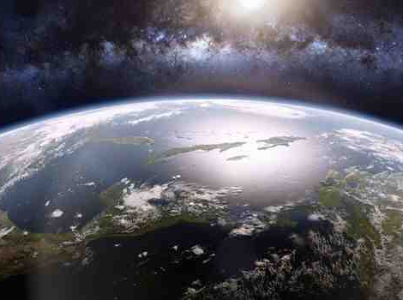
The Unfinished Work of Jesus
John 19:23-30

Slide 2
Jesus changed the world more than any other..
No man ever accomplished more in a brief life..
Jesus changes everyone He comes in contact..
You can’t escape His influence..

Slide 3
We celebrate what Jesus has done for us..
Redeemed our past..
Secured our future..
He is also actively involved in our today..

Slide 4
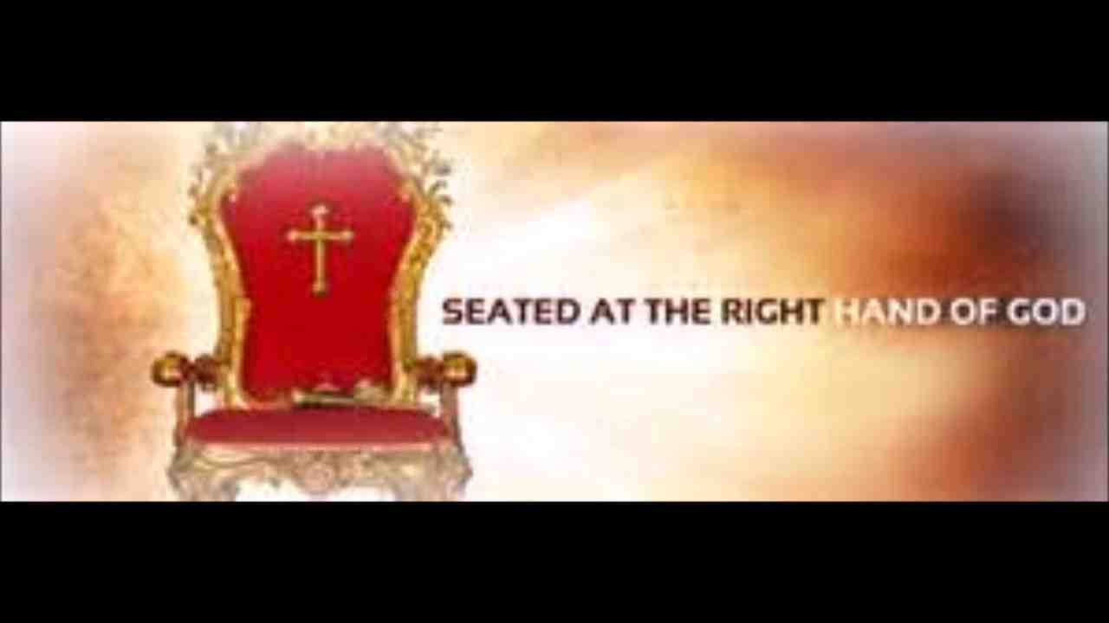
1 Ruling in power..
Heb 1:1-3 God.. has in these last days spoken to us by His Son, whom He has appointed heir of all things..being the brightness of His glory and the express image of His person, and upholding all things by the word of His power, when He had by Himself purged our sins, sat down at the right hand of the Majesty on high..

Slide 5
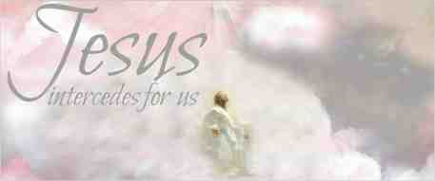
2 Interceding on our behalf..
Heb 7:25 Therefore He is also able to save to the uttermost those who come to God through Him, since He always lives to make intercession for them.

Slide 6
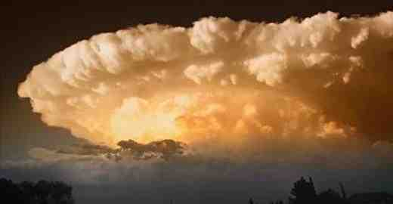
3 Preparing a place for us..
John 14:1-3 “Let not your heart be troubled; you believe in God, believe also in Me. ² In My Father’s house are many mansions; if it were not so, I would have told you. I go to prepare a place for you. ³ And if I go and prepare a place for you, I will come again and receive you to Myself; that where I am, there you may be also.

Slide 7
The Unfinished Work of Jesus
John 19:23-30

