Slide 1
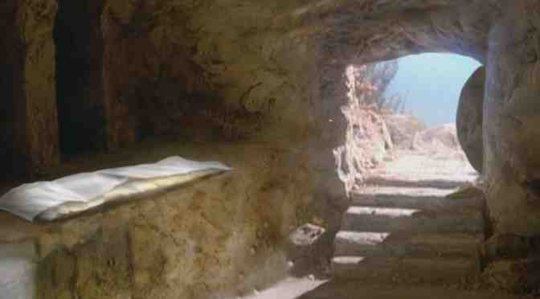
Made Alive in Christ
Ephesians 2:1-7

Slide 2
Our condition without Christ..
We were dead in sins.. V 1
Under the control of.. V 2
The world
Satan (prince of air)
The flesh
Children of wrath.. V 3

Slide 3
But God raised us with Christ..
God acted for us..
Rich in mercy
Loved us with great love
Seated us with Christ
Why He did this..
Show us His grace in ages to come

Slide 4
Made Alive in Christ
Ephesians 2:1-7

