Slide 1
We are God’s Workmanship
Ephesians 2:8-10

Slide 2
Amazing spiritual blessings
Chosen by God..
Redeemed by Christ..
Sealed by the Holy Spirit..

Slide 3
God’s great power saved us
We were dead in our sins..
But God made us alive with Christ

Slide 4
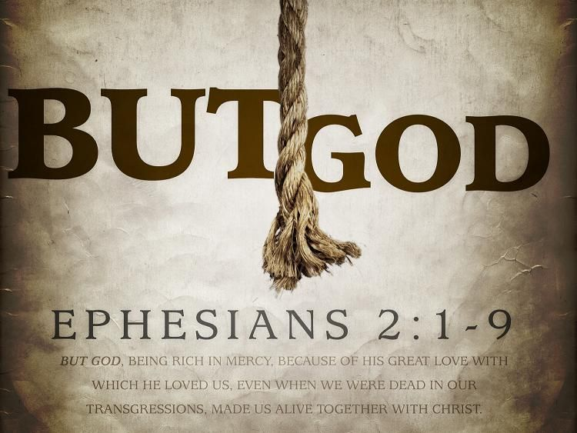
We were lost, but God..
God has a purpose for our lives..

Slide 5
Saved by grace through faith..
2:5 (by grace you have been saved)..
2:8 For by grace you have been saved through faith, and that not of yourselves; it is the gift of God..
Worth repeating because we forget..

Slide 6
This not of yourselves…
Our faith?.. (wrong grammar)
Our salvation was not of ourselves.. it was activated by God

Slide 7
Through faith..
A requirement on our part..
There must be our response..
Faith.. Trust (Hab 2:4; Rom 1:17)
(I will trust the Lord to do anything He asks)
(Baptism.. Put others ahead of ourselves)

Slide 8
Not of works..
Works we contribute to save ourselves..
Faith is always active, but these are the evidence of faith (not the basis of salvation).. Jm 2:14-26
God does not want us boasting in ourselves

Slide 9
We are His workmanship
The work of a craftsman..
We are created new..
We are saved for a purpose.. Walk in good works

Slide 10
We are God’s Workmanship
Ephesians 2:8-10

