Slide 2
Do you know who you are..
Find your identity in Christ..
You are saints –
You are chosen, destined –
You are accepted, redeemed -
You have an inheritance –
You are sealed –

Slide 3
The Gospel is about.. Change and Choice
Change: from old life to a new way of life.. 1-3
Salvation, Conversion – a gift of God
Choice: what we do with our new life.. 4-6
Choice of unity/disunity.. good/bad family life, relationships

Slide 4
Written to our Needs..
Human beings .. Sin, darkness
God reaching out to create a new society
Who we are in Christ..
Who we really are..
We need to belong..
Life is hard, we need help..

Slide 5
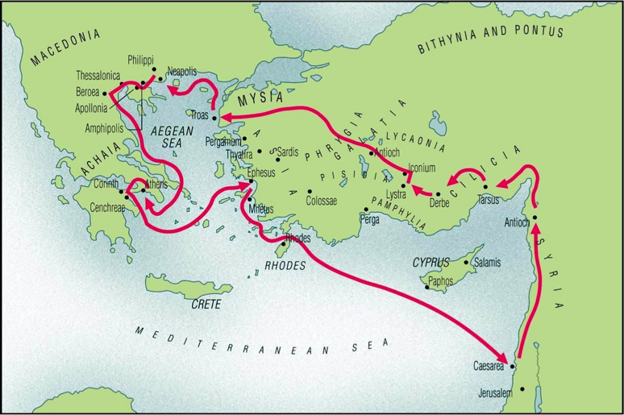
Basics of the letter.. 1:1-3
The author (Paul).. Eph 1:1
The assembly.. Eph 1:1-2
Saints and faithful..
The aim.. Eph 1:3
Our riches in Christ..
The analysis..
Doctrine: our riches in Christ – ch 1-3
Duty: our responsibilities in Christ – ch 4-6

