Slide 1
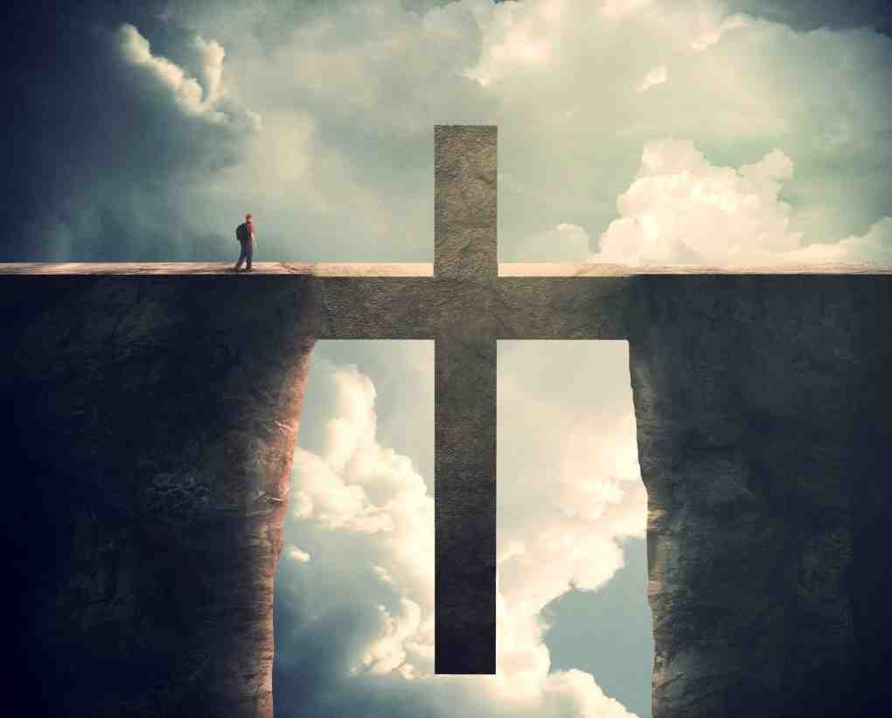
Reconciled By the Cross
Ephesians 2:11-18

Slide 2
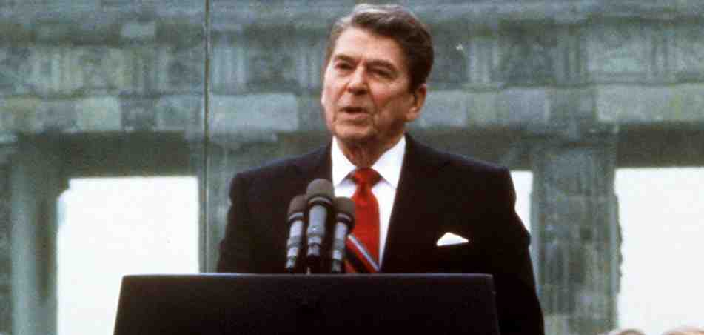
Reagan at Berlin Wall 1987
“Tear down this wall”

Slide 3
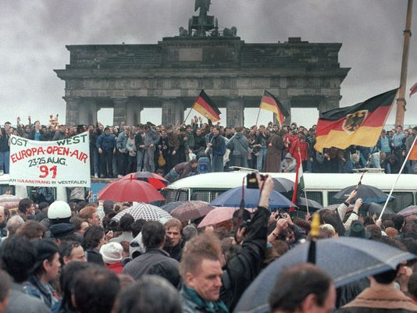
Berlin Wall ended 1989

Slide 4
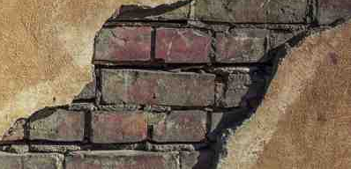
Jews and Gentiles separation
JEWS
GENTILES
Dividing Wall of Separation

Slide 5
Remember what we were..
Eph 2: 11-12 Therefore remember that you, once Gentiles in the flesh—who are called Uncircumcision by what is called the Circumcision made in the flesh by hands— ¹² that at that time you were without Christ, being aliens from the commonwealth of Israel and strangers from the covenants of promise, having no hope and without God in the world.

Slide 6
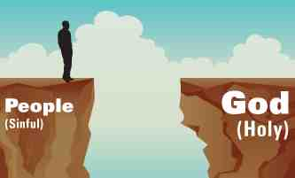
Sin Separates us from God
Sin also separates us from each other..

Slide 7
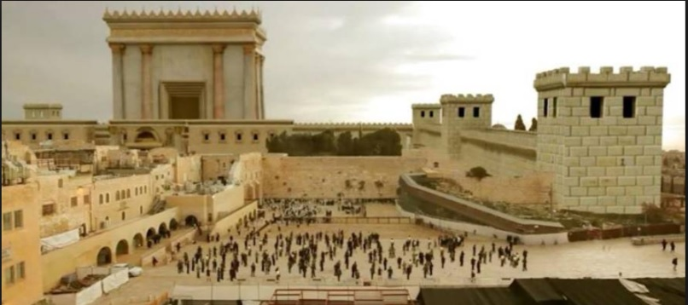
Remember what we were..
Socially.. “Uncircumcision” vs “Circumcision”
Spiritually.. Without Christ
Nationally.. Aliens from the Commonwealth of Israel
Culturally.. Strangers from the covenants of promise
Personally.. Having no hope, without God in world

Slide 8
What We are Now..
Once we were far off.. Now we are near..
13 But now in Christ Jesus you who once were far off have been brought near by the blood of Christ.
Once we were separated.. Now we are united..
¹⁴ For He Himself is our peace, who has made both one, and has broken down the middle wall of separation,

Slide 9
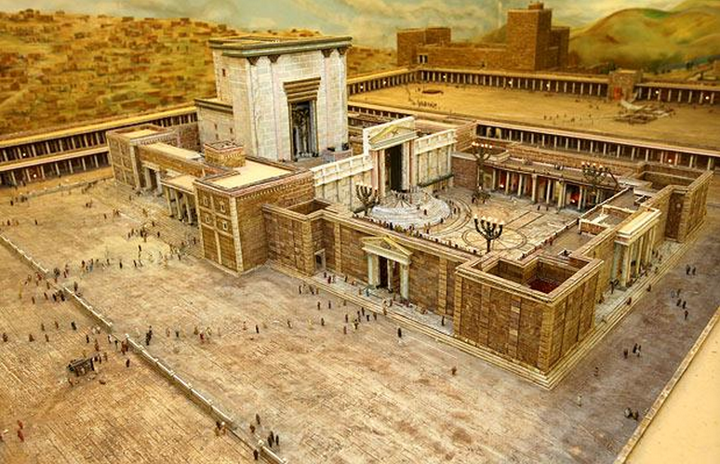

Slide 10
What We are Now..
Once we were two men.. Now we are one..
- 15 having abolished in His flesh the enmity, that is, the law of commandments contained in ordinances, so as to create in Himself one new man from the two, thus making peace,
Once we were excluded.. Now we are admitted..
17 And He came and preached peace to you who were afar off and to those who were near. ¹⁸ For through Him we both have access by one Spirit to the Father.

Slide 11
Reconciled By the Cross
Ephesians 2:11-18

