Slide 1
God’s Mystery Revealed
Ephesians 3:1-7

Slide 2
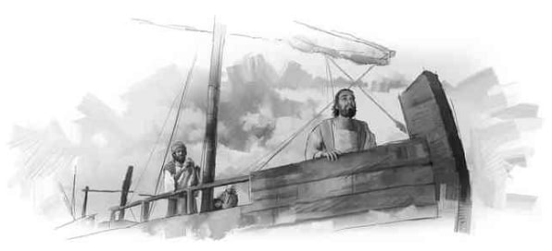
Paul’s unique role..
Apostle to the Gentiles
God’s mystery revealed to him.. v 2
God’s mission entrusted to him.. v 7
The Dispensation of the Grace of God

Slide 3
Ephesians 3:1-7
3 For this reason I, Paul, the prisoner of Christ Jesus for you Gentiles— ² if indeed you have heard of the dispensation of the grace of God which was given to me for you, ³ how that by revelation He made known to me the mystery (as I have briefly written already,
⁴ by which, when you read, you may understand my knowledge in the mystery of Christ), ⁵ which in other ages was not made known to the sons of men, as it has now been revealed by the Spirit to His holy apostles and prophets:
⁶ that the Gentiles should be fellow heirs, of the same body, and partakers of His promise in Christ through the gospel, ⁷ of which I became a minister according to the gift of the grace of God given to me by the effective working of His power.

Slide 4
Paul’s prayer..
3:1 For this reason I, Paul..
Beginning to pray.. Interrupts his prayer
3:14 For this reason I bow my knees to the Father of our Lord Jesus Christ, ¹⁵ from whom the whole family in heaven and earth is named..
Why the interruption?
- To explain his unique role to the Gentiles

Slide 5
Paul’s perspective…
3 For this reason I, Paul, the prisoner of Christ Jesus for you Gentiles—
Paul saw himself a prisoner of Christ
His imprisonment was for the Gentiles
Acts 21:28 “This is the man who teaches all men everywhere against the people, the law, and this place..”
Acts 22:21-22 Then He said to me, ‘Depart, for I will send you far from here to the Gentiles.’ ” ²² And they listened to him until this word, and then they raised their voices and said, “Away with such a fellow from the earth, for he is not fit to live!”

Slide 6
Paul’s privilege..
God’s divine revelation to Paul
3:2 indeed you have heard of the dispensation of the grace of God which was given to me for you,
³ how that by revelation He made known to me the mystery..
Paul wrote the revelation for us..
3 (as I have briefly written already, ⁴ by which, when you read, you may understand my knowledge in the mystery of Christ)..

Slide 7
Paul’s privilege
God’s mystery made known…
⁵ which in other ages was not made known to the sons of men, as it has now been revealed by the Spirit to His holy apostles and prophets: ⁶ that the Gentiles should be fellow heirs, of the same body, and partakers of His promise in Christ through the gospel..
Paul’s mission to make this known..
⁷ of which I became a minister according to the gift of the grace of God given to me by the effective working of His power.

Slide 8
God’s Mystery Revealed
Ephesians 3:1-7

