Slide 1
His Grace and Our Gifts
Ephesians 4:7-12

Slide 2
Diversity within the church
God gives gifts to each of us individually..
We give them back to Him in service

Slide 3
I. The Provision of Gifts (v 7)
⁷ But to each one of us grace was given according to the measure of Christ’s gift.
A. The Gifts of His Grace…
B. The Grace to use our Gifts..

Slide 4
II. The Price of our Gifts (8-10)
A. The Old Testament promise v 8
⁻ ⁸ Therefore He says:“When He ascended on high, He led captivity captive, and gave gifts to men.”

Slide 5
II. The Price of our Gifts (8-10)
B. The New Testament proof (9-10)
⁹ (Now this, “He ascended”—what does it mean but that He also first descended into the lower parts of the earth? ¹⁰ He who descended is also the One who ascended far above all the heavens, that He might fill all things.)

Slide 6
III. The Purpose of Gifts (11-12)
Foundation of the church (v 11)
¹¹ And He Himself gave some to be apostles, some prophets, some evangelists, and some pastors and teachers..

Slide 7
III. The Purpose of Gifts (11-12)
Functioning of the church (v 12)
¹² for the equipping of the saints for the work of ministry, for the edifying of the body of Christ,

Slide 8
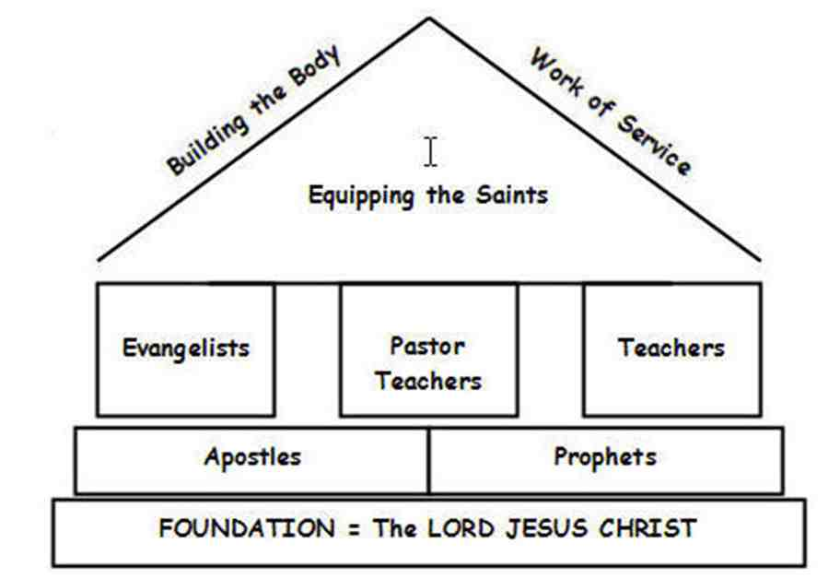

Slide 9
Let us each use our gift..

Slide 10
His Grace and Our Gifts
Ephesians 4:7-12

