Slide 1
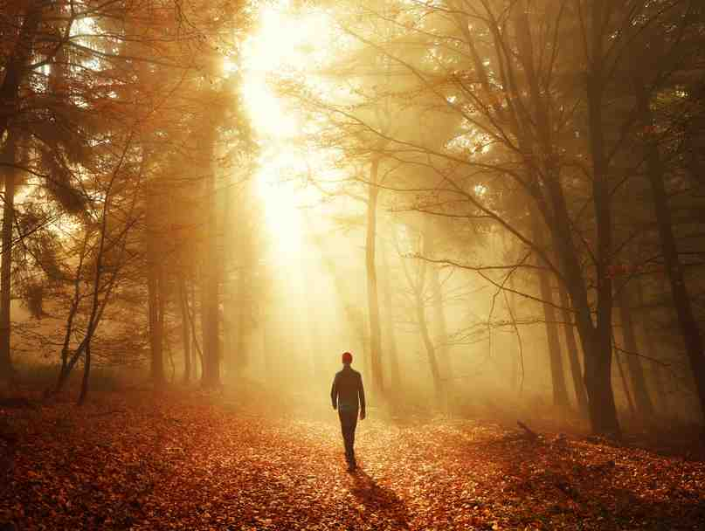
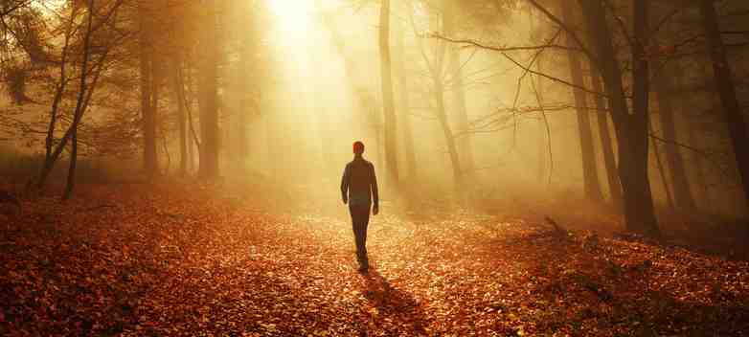
Walk as Children of Light
Ephesians 5:8-14

Slide 2
New Identity
Eph 5:8 For you were once darkness, but now you are light in the Lord.

Slide 3
14 Therefore He says: “Awake, you who sleep, Arise from the dead, And Christ will give you light.”
Genesis 1:2-4 Then God said, “Let there be light”; and there was light. ⁴ And God saw the light, that it was good; and God divided the light from the darkness.

Slide 4
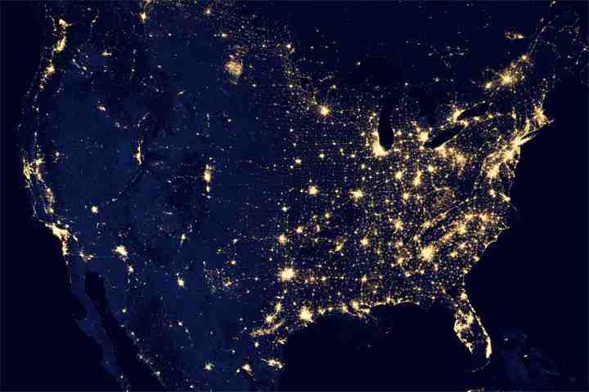

Slide 5
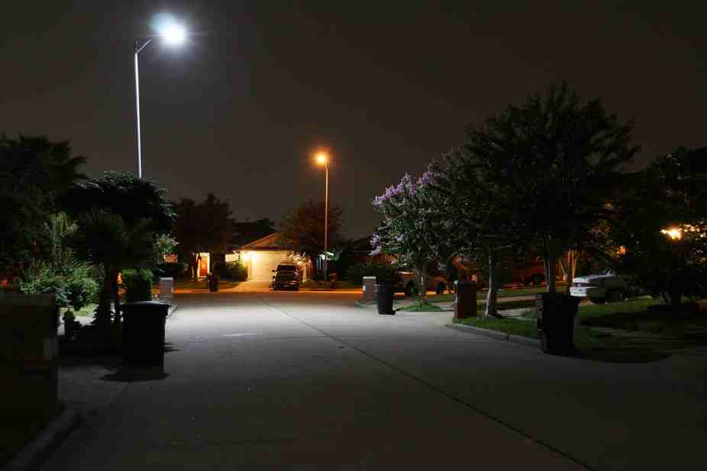
Good lighting helps prevent crime

Slide 6
You were once darkness

Slide 7
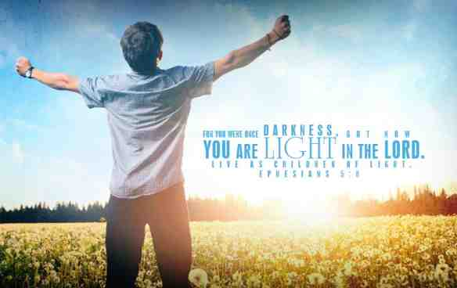
Now you are light in the Lord

Slide 8
New Direction
8b Walk as children of light ⁹ (for the fruit of the Spirit is in all goodness, righteousness, and truth), ¹⁰ finding out what is acceptable to the Lord.

Slide 9
Fruit of the Spirit (Light)
Goodness, Righteousness, and Truth

Slide 10
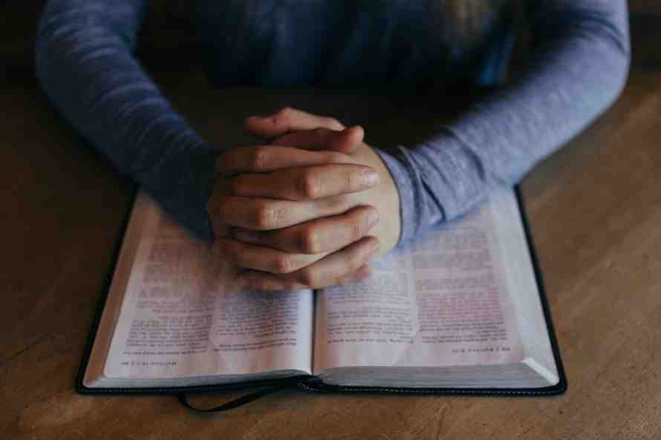
Finding what is acceptable to the Lord

Slide 11
New Desire
11 And have no fellowship with the unfruitful works of darkness, but rather expose them. ¹² For it is shameful even to speak of those things which are done by them in secret.

Slide 13
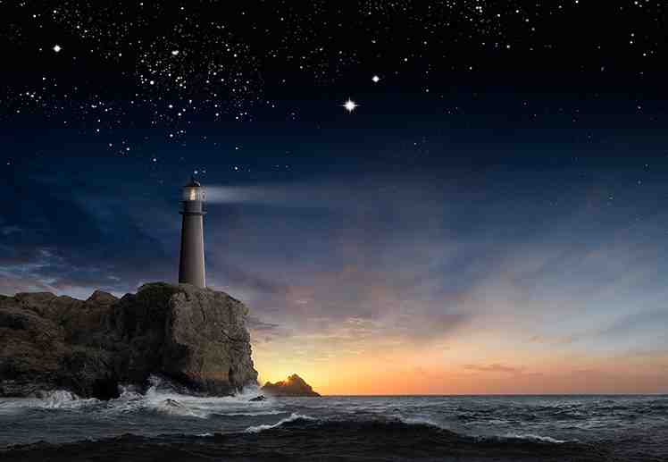
Letting your light shine

Slide 14
New Impact
13 But all things that are exposed are made manifest by the light, for whatever makes manifest is light. ¹⁴ Therefore He says: “Awake, you who sleep, Arise from the dead, And Christ will give you light.”

Slide 16
Walk as Children of Light
Ephesians 5:8-14

