Slide 1
Ephesians 5:1-7

Slide 2
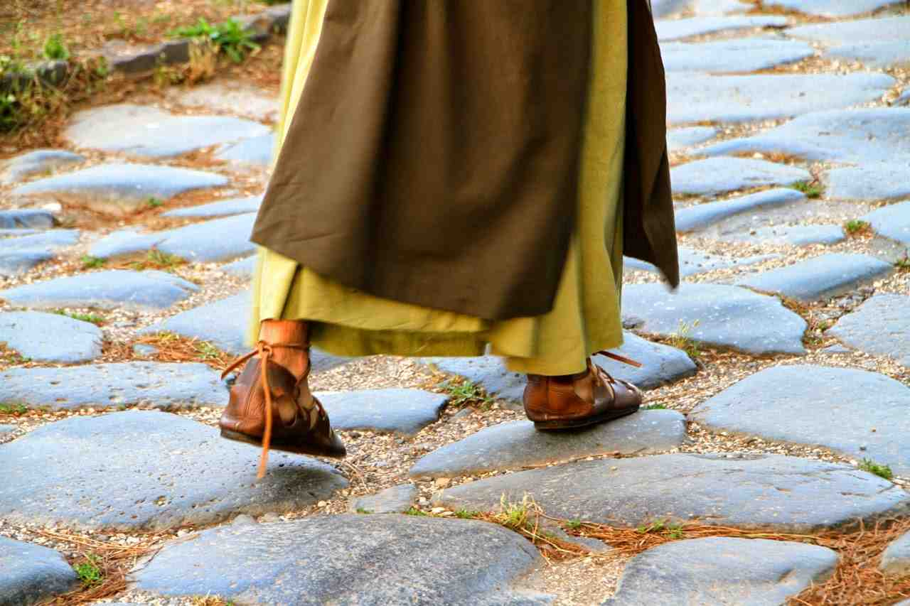
The Call to Walk in Love..
5:1 Therefore be imitators of God as dear children. ² And walk in love..

Slide 3
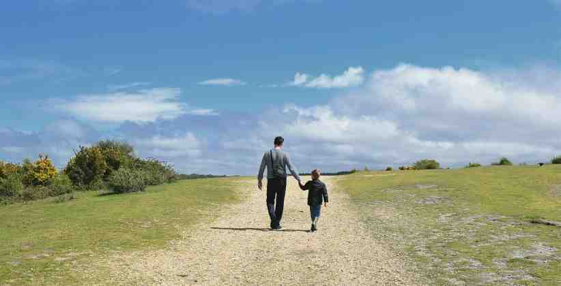
Imitators of God..
“Mimic” God in the way we act kindly toward others, forgiving as we have been forgiven..

Slide 4
The Pattern for Walking in Love..
2 .. as Christ also has loved us and given Himself for us, an offering and a sacrifice to God for a sweet-smelling aroma.

Slide 5
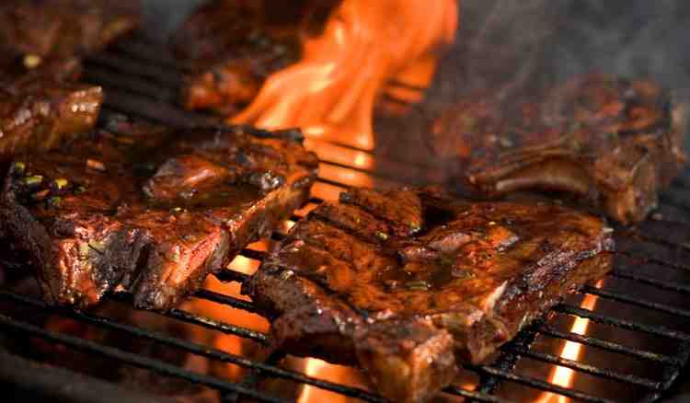
The aroma of grilling meat

Slide 6
The Counterfeit to Walking in Love..
³ But fornication and all uncleanness or covetousness, let it not even be named among you, as is fitting for saints; ⁴ neither filthiness, nor foolish talking, nor coarse jesting, which are not fitting, but rather giving of thanks.

Slide 7
The Counterfeit to Walking in Love..
Fornication (porneia)
Uncleanness
Covetousness
Filthiness
Foolish talking
Course jesting

Slide 8
The Cost of Not Walking in Love..
⁵ For this you know, that no fornicator, unclean person, nor covetous man, who is an idolater, has any inheritance in the kingdom of Christ and God. ⁶ Let no one deceive you with empty words, for because of these things the wrath of God comes upon the sons of disobedience. ⁷ Therefore do not be partakers with them.

Slide 9
Ephesians 5:1-7

