Slide 1
Christ Centered Marriage
Ephesians 5:21-33

Slide 2
Walking worthy of calling..
Eph 4:1-16
Eph 4:17-5:20

Slide 3
Practical daily relationships..
At home and work..

Slide 4
Context for our relationships
Eph 5:18-21 be filled with the Spirit..submitting to one another in the fear of Christ..

Slide 5
Submission responsibilities
Wives to their husbands
Children to their parents
Slaves to their masters

Slide 6
The Duty of Wives.. 22-24
Wives are to submit.. (Husbands are to love..)
Mutual concept.. 21 (to one another)
The center.. 22 (as to the Lord)
The context.. 22 (to your own husbands)
The example.. 24 (as the church unto Christ)
The consequence.. (help husband to love her)

Slide 7
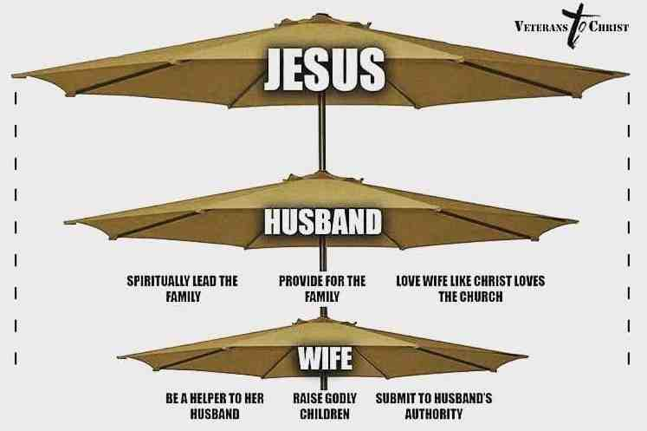
Submit to your husbands..as to the Lord

Slide 8
The Duty of Husbands..25-33
Husbands are to love..
As Christ loved the church..25 (unconditionally)
And gave himself for her..25 (sacrificially)
To present her to himself..26-27 (purposefully)
As he loves himself..28-33 (passionately)
Nourish your wife
Cherish your wife

Slide 9
The great mystery..
³² This is a great mystery, but I speak concerning Christ and the church. ³³ Nevertheless let each one of you in particular so love his own wife as himself, and let the wife see that she respects her husband.

Slide 10
Christ Centered Marriage
Ephesians 5:21-33

