Slide 1
Staying Strong with Prayer
Ephesians 6:18-24

Slide 2
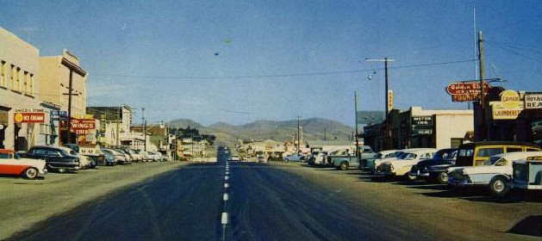
50 Years ago.. June 1969
Cayucos, California

Slide 3
Our spiritual struggle..
Eph 6:11-12 Put on the whole armor of God that you may be able to stand against the wiles of the devil. ¹² For we do not wrestle against flesh and blood, but..spiritual hosts of wickedness..
Col 1:28-2:1 So we may present everyone perfect in Christ. To this end I labor, struggling with all His energy which so powerfully works in me. I want you to know how much I am struggling for you, and for those in Laodicea, and for all whohave not known me personally.

Slide 4
Praying in the Spirit..
Eph 6:18-20 praying always with all prayer and supplication in the Spirit, being watchful to this end with all perseverance and supplication for all the saints— ¹⁹ and for me, that utterance may be given to me, that I may open my mouth boldly to make known the mystery of the gospel, ²⁰ for which I am an ambassador in chains; that in it I may speak boldly, as I ought to speak.

Slide 5
Pray at all times..
Acts 2:42 continued steadfastly in prayer
Rom 12:12 continuing steadfastly in prayer
Col 4:2 Continue steadfastly in prayer

Slide 6
Pray with all prayer..
Phil 4:6-7 Be anxious for nothing, but in every-thing by prayer and supplication, with thanks-giving, let your requests be made known to God..
Pray all kinds of prayer
Thanks, needs, strength, help

Slide 7
Pray with all perseverance..
Luke 18:1 Then He spoke a parable to them, that men always ought to pray and not lose heart..
Danger of praying at times, then stopping
Because we do not get answers immediately

Slide 8
Pray for all the saints..
Phil 1:4 always in every prayer of mine making request for you all with joy..
Eph 6:19-20 and for me, that utterance may be given to me, that I may open my mouth boldly to make known the mystery of the gospel, ²⁰ for which I am an ambassador in chains; that in it I may speak boldly, as I ought to speak.

Slide 9
Personal matters - Tychicus
6:21-22 But that you also may know my affairs and how I am doing, Tychicus, a beloved brother and faithful minister in the Lord, will make all things known to you; ²² whom I have sent to you for this very purpose, that you may know our affairs, and that he may comfort your hearts.

Slide 10
Closing blessing..
6:23-24 Peace to the brethren, and love with faith, from God the Father and the Lord Jesus Christ. ²⁴ Grace be with all those who love our Lord Jesus Christ in sincerity. Amen.

Slide 11
Staying Strong with Prayer
Ephesians 6:18-24

