Slide 1
The Whole Armor of God
Ephesians 6:10-17

Slide 2
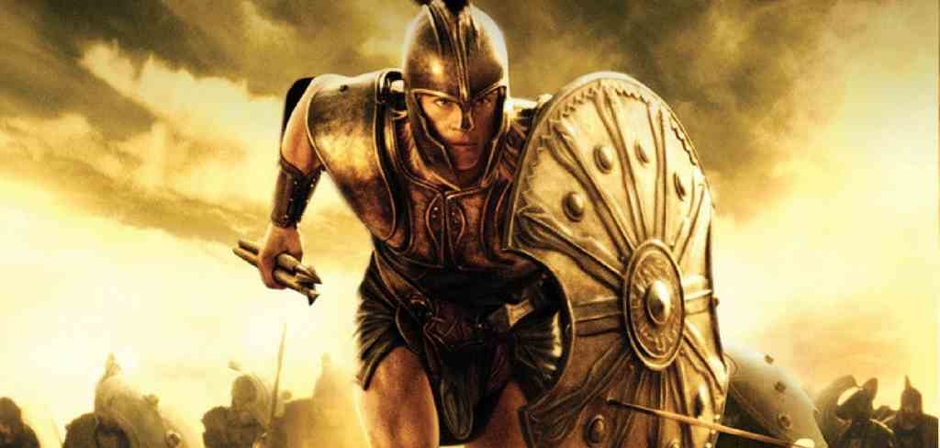
Be Strong in the Lord..
Eph 6:10 “Finally, my brethren..”
1:18-19 exceeding greatness of His power that works in us..
3:16-20 strengthened with might through His Spirit in the inner man.. power that works in us

Slide 3
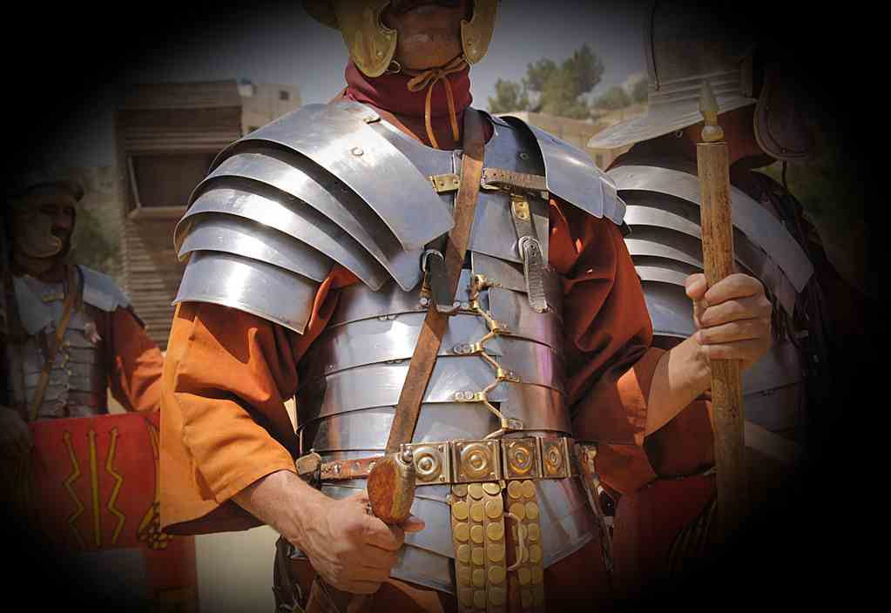
Put on the Whole Armor of God
6:11-13 Put on the whole armor of God..
To stand against the wiles of the devil.
To wrestle spiritual powers of darkness.
To withstand in the evil day.

Slide 4
Belt of Truth..
John 8:32 And you shall know the truth, and the truth shall make you free.”
1 Peter 1:22-23 Since you have purified your souls in obeying the truth through the Spirit..

Slide 5
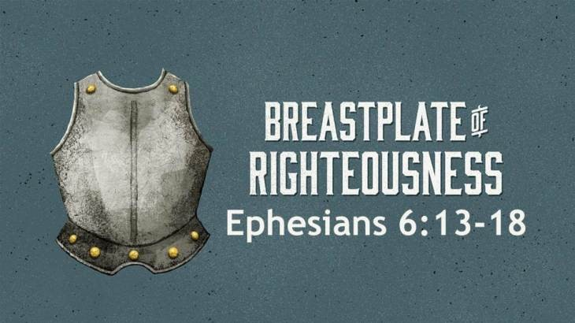
Breastplate of Righteousness..
1 Thess 5:8 But let us who are of the day be sober, putting on the breastplate of faith and love..
Titus 2:11-12 teaching us that, denying ungod-liness and worldly lusts, we should live soberly, righteously, and godly in the present age..

Slide 6
Shoes of the Gospel of Peace
John 14:27 Peace I leave with you, My peace I give to you; not as the world gives do I give to you.
Rom 5:1-2 having been justified by faith, we have peace with God through our Lord Jesus Christ..

Slide 7
The Shield of Faith
Rom 10:17 faith comes by hearing, and hearing by the word of God.
Heb 11:1 Now faith is the substance of things hoped for, the evidence of things not seen.

Slide 8
Helmet of Salvation..
1 Thess 5:8 But let us who are of the day be sober, putting on .. as a helmet the hope of salvation.
1 John 5:11-12 And this is the testimony: that God has given us eternal life, and this life is in His Son.

Slide 9
Sword of the Spirit..
Matt 4:4-10 It is written.. man shall not live by bread alone but every word from mouth of God..
Heb 4:12 the word of God is living and active and sharper than any two edged sword..

Slide 10
Having done all.. To Stand

Slide 11
The Whole Armor of God
Ephesians 6:10-17

