Slide 1
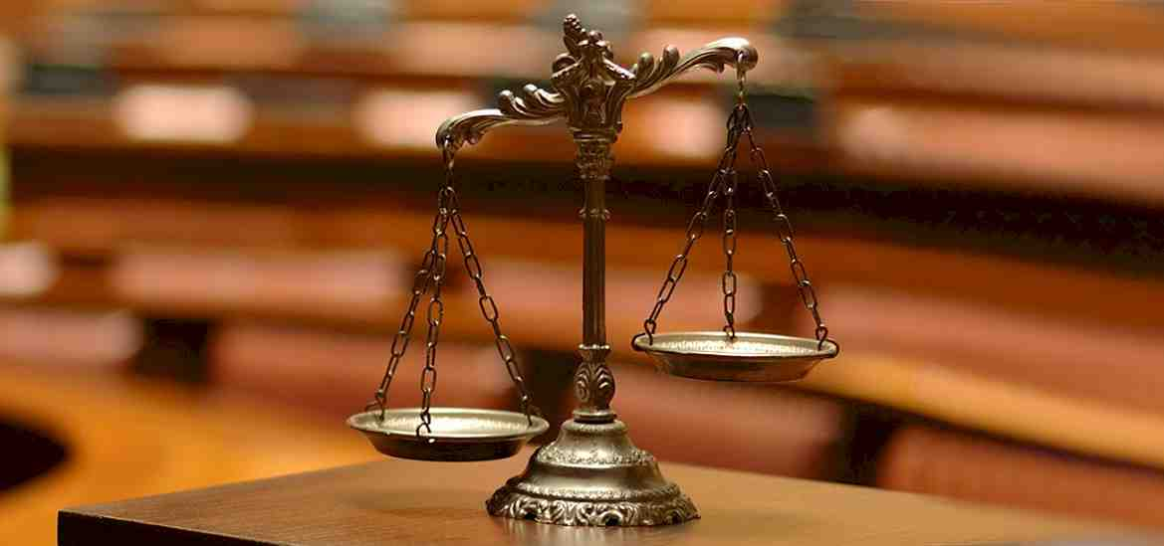
Beyond Reasonable Doubt
2 Peter 1:13-21

Slide 2
Uniqueness of Christianity..
Acts 26:26 For the king, before whom I also speak freely, knows these things; for I am convinced that none of these things escapes his attention, since this thing was not done in a corner.

Slide 3
Based on historical facts..
2 Peter 1:16 “We did not follow cleverly invented stories when we told you about the power and coming of our Lord Jesus Christ, but we were eyewitnesses of His majesty.”

Slide 4
1 Jesus provided evidence..
Acts 1:3 to whom He also presented Himself alive after His suffering by many infallible proofs, being seen by them during forty days and speaking of the things pertaining to the kingdom of God.
John 5:36-40 But I have a greater witness than John’s; for the works which the Father has given Me to finish—the very works that I do—bear witness of Me, that the Father has sent Me.

Slide 5
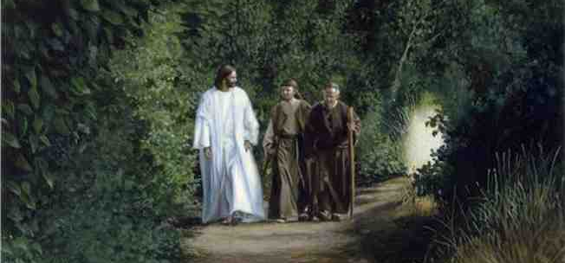
1 Jesus provided evidence..
Luke 24:25-27 “Ought not the Christ to have suffered these things and to enter into His glory?” ²⁷ And beginning at Moses and all the Prophets, He expounded to them in all the Scriptures the things concerning Himself.

Slide 6
2 Evidence in apostles’ preaching..
Acts 2:22-24 “Men of Israel, hear these words: Jesus of Nazareth, a Man attested by God to you by miracles, wonders, and signs which God did through Him in your midst, as you yourselves also know—
2:32 This Jesus God has raised up, of which we are all witnesses.

Slide 7
2 Evidence in apostles’ preaching..
Acts 13:27 For those who dwell in Jerusalem, and their rulers, because they did not know Him, nor even the voices of the Prophets which are read every Sabbath, have fulfilled them in condemning Him.
31 He was seen for many days by those who came up with Him from Galilee to Jerusalem, who are His witnesses to the people.

Slide 8
3 Purpose of the Evidence..
Luke 1:1-4 Inasmuch as many have taken in hand to set in order a narrative of those things which have been fulfilled among us, ² just as those who from the beginning were eyewitnesses and ministers of the word delivered them to us..
3-4 that you may know the certainty of those things in which you were instructed.

Slide 9
3 Purpose of the Evidence..
To strengthen our faith..
1 Cor 15:20, 58 Therefore, my beloved brethren, be steadfast, immovable, always abounding in the work of the Lord, knowing that your labor is not in vain in the Lord.
To prepare us to share faith with others..
1 Peter 3:15 But sanctify the Lord God in your hearts, and always be ready to give a defense to everyone who asks you a reason for the hope that is in you, with meekness and fear..

Slide 10
Beyond Reasonable Doubt
2 Peter 1:13-21

