Slide 1
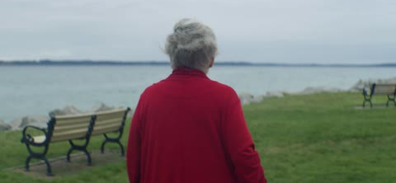
Caring for Widows
Psalm 68:1-5

Slide 2
1 How God sees widows..
Psalm 68:5 A father of the fatherless, a defender of widows, is God in His holy habitation.
Deut 10:18 He administers justice for the fatherless and the widow, and loves the stranger, giving him food and clothing.

Slide 3
1 He cares for them..
Exodus 22:22-24 “You shall not afflict any widow or fatherless child. ²³ If you afflict them in any way, and they cry at all to Me, I will surely hear their cry; ²⁴ and My wrath will become hot, and I will kill you with the sword; your wives shall be widows, and your children fatherless.

Slide 4
1 He defends them..
Jeremiah 22:3-4 “Execute judgment and righteousness, and deliver the plundered out of the hand of the oppressor. Do no wrong and do no violence to the stranger, the fatherless, or the widow, nor shed innocent blood in this place.
Ruth 2:1-14 Boaz’s example of special care for Ruth the Moabitess and Naomi..

Slide 5
1 He provides for them..
Mark 12:41-44 Jesus sees and commends the widow in the temple..
Acts 6:1-4 Special attention shown by apostles
James 1:27 Pure and undefiled religion before God and the Father is this: to visit orphans and widows in their trouble, and to keep oneself unspotted from the world.

Slide 6
2 Our responsibility to them..
Isaiah 1:17 Defend the fatherless, Plead for the widow.
James 1:27 Pure religion.. to visit orphans and widows in their trouble..

Slide 7
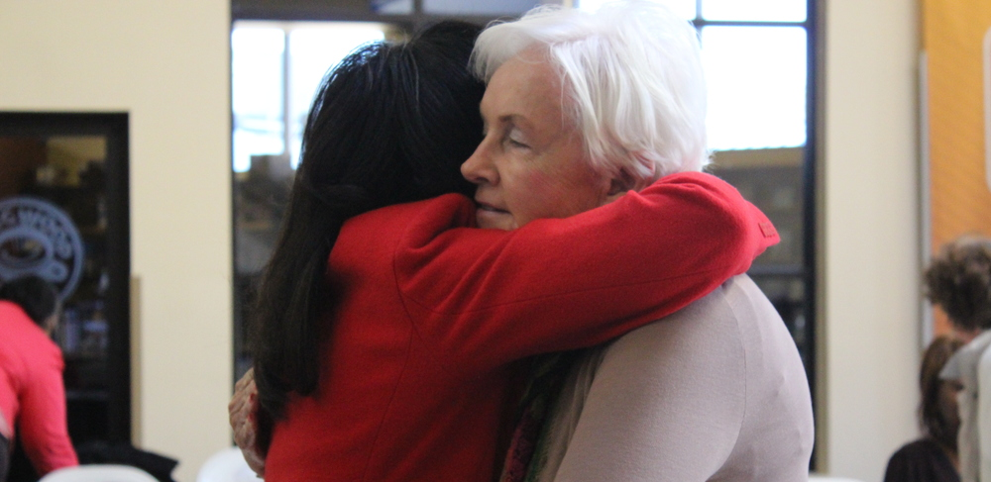
2 Our responsibility to them..
1 Timothy 5:1-16 most thorough instruction..
Age consideration.. proper respect
Honoring widows.. different categories
Evaluating their needs.. widows with families
Possible support of widows indeed..

Slide 8
Caring for Widows
Psalm 68:1-5

