Slide 1
Enjoying Liberty
Galatians 5:1-13

Slide 2
We have liberty in Christ
Galatians 5:1 Stand fast therefore in the liberty by which Christ has made us free, and do not be entangled again with a yoke of bondage.
John 8:32 “If you abide in My word, you are My disciples indeed. ³² And you shall know the truth, and the truth shall make you free.”

Slide 3
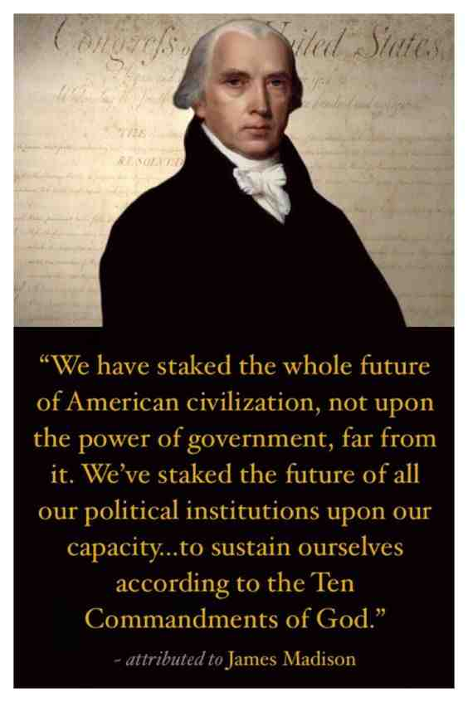
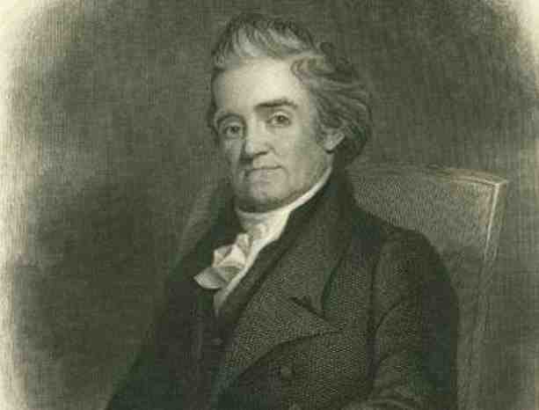
What is the proper use of freedom?
The principles of genuine liberty and of wise laws and administrations are to be drawn from the Bible and sustained by its authority

Slide 4
How do we use our freedom?
Gal 5:1 For freedom Christ has set us free; stand firm therefore, and do not submit again to a yoke of slavery.

Slide 5
What does freedom in Christ mean to you?
Freedom implies a prior bondage..
Set free from Egypt ..
Free to serve God
Liberty comes from following God..
John 8:32-36
Romans 8:1-3
1 Peter 2:13-17
Romans 6:1-22

Slide 6
Enjoying Liberty
Galatians 5:1-13

