Slide 1
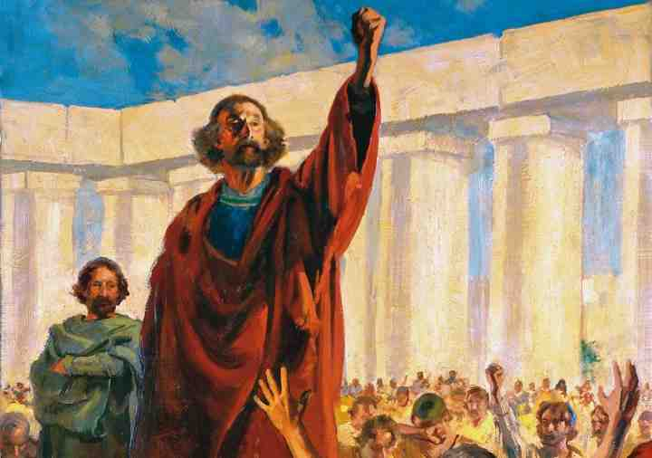
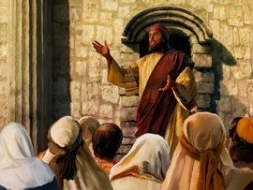
Peter’s Sermon at Pentecost
Acts 2:22-41

Slide 2
The Day of Pentecost
Outpouring of the Holy Spirit..
Fulfillment of Joel, John, Jesus..
First gospel sermon.. Conversion of 3000
Beginning of the church..

Slide 3
“Hear these words..
14 Men of Judea.. Heed my words
22 Men of Israel.. Hear my words
29 Men and brethren.. Let me speak freely
40 with many other words he testified
41 Those who gladly received his word

Slide 4
The Sermon (22-36)
Jesus attested by God (22)
Jesus put to death (23)
Jesus raised by God (24-31)
Jesus exalted as Lord (33-36)

Slide 5
Jesus attested by God (22)
22 Men of Israel, hear these words: Jesus of Nazareth, a Man attested by God to you by miracles, wonders, and signs which God did through Him in your midst, as you yourselves also know—

Slide 6
Jesus put to death (23)
23 Him, being delivered by the determined purpose and foreknowledge of God, you have taken by lawless hands, have crucified, and put to death;

Slide 7
Jesus raised by God (24)
24 whom God raised up, having loosed the pains of death, because it was not possible that He should be held by it.

Slide 8
Proof by scripture..
25 For David says concerning Him:
#1 (Psalm 16:8-11)
25 ‘I foresaw the Lord always before my face, For He is at my right hand, that I may not be shaken. 26 Therefore my heart rejoiced, and my tongue was glad; Moreover my flesh also will rest in hope.
27 For You will not leave my soul in Hades, Nor will You allow Your Holy One to see corruption. 28 You have made known to me the ways of life; You will make me full of joy in Your presence.’

Slide 9
Further proof
29 “Men and brethren, let me speak freely to you of the patriarch David, that he is both dead and buried, and his tomb is with us to this day.
#2 (Psalm 132:11)
³⁰ Therefore, being a prophet, and knowing that God had sworn with an oath to him that of the fruit of his body, according to the flesh, He would raise up the Christ to sit on his throne, ³¹ he, foreseeing this, spoke concerning the resurrection of the Christ, that His soul was not left in Hades, nor did His flesh see corruption.

Slide 10
Eyewitness testimony
32 This Jesus God has raised up, of which we are all witnesses.

Slide 11
Jesus exalted as Lord
³³ Therefore being exalted to the right hand of God, and having received from the Father the promise of the Holy Spirit, He poured out this which you now see and hear. ³⁴ “For David did not ascend into the heavens, but he says himself:
#3 (Psalm 110:1)
‘The Lord said to my Lord, “Sit at My right hand, ³⁵ Till I make Your enemies Your footstool.” ’

Slide 12
Conclusion
³⁶ “Therefore let all the house of Israel know assuredly that God has made this Jesus, whom you crucified, both Lord and Christ.”
³⁷ Now when they heard this, they were cut to the heart, and said to Peter and the rest of the apostles, “Men and brethren, what shall we do?”
³⁸ Then Peter said to them, “Repent, and let every one of you be baptized in the name of Jesus Christ for the remission of sins; and you shall receive the gift of the Holy Spirit.

Slide 13
Peter’s Sermon at Pentecost
Acts 2:22-41

