Slide 1
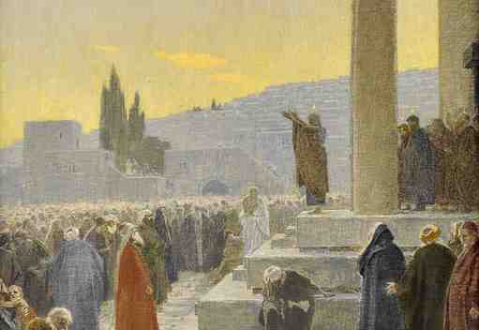
The Power of Pentecost
Acts 2:1-21

Slide 2
Acts 1 The Apostles Waiting
1:1-3 Jesus seen 40 days, speaking with them
1:4-5 Wait in Jerusalem for the promise
1:8 To receive power when Holy Spirit came
1:12-14 Continuing together in prayer

Slide 3
The Right Place
Acts 2:1 When the Day of Pentecost had fully come, they were all with one accord in one place.
Pentecost – 50 days from Passover
Feast of weeks, Firstfruits – Lev 23:15
Coming of the Holy Spirit
A sound from heaven (as a rushing wind)
Divided tongues (as of fire) one sat on each
The Power ..
V 4 And they were all filled with the Holy Spirit and began to speak with other tongues, as the Spirit gave them utterance.

Slide 4
The Right Timing
Acts 2:5-8 And there were dwelling in Jerusalem Jews, devout men, from every nation under heaven. 6 And when this sound occurred, the multitude came together, and were confused, because everyone heard them speak in his own language. 7 Then they were all amazed and marveled, saying to one another, “Look, are not all these who speak Galileans? 8 And how is it that we hear, each in our own language in which we were born?

Slide 5
The Right Reaction
Acts 2:9-12 Parthians and Medes and Elamites, those dwelling in Mesopotamia, Judea and Cappadocia, Pontus and Asia, ¹⁰ Phrygia and Pamphylia, Egypt and the parts of Libya adjoining Cyrene, visitors from Rome, both Jews and proselytes, ¹¹ Cretans and Arabs—we hear them speaking in our own tongues the wonderful works of God.” ¹² So they were all amazed and perplexed, saying to one another, “Whatever could this mean?”¹³ Others mocking said, “They are full of new wine.”

Slide 6
The Right Message
Acts 2:14-17 But Peter, standing up with the eleven, raised his voice and said to them, “Men of Judea and all who dwell in Jerusalem, let this be known to you, and heed my words. ¹⁵ For these are not drunk, as you suppose, since it is only the third hour of the day. ¹⁶ But this is what was spoken by the prophet Joel: ¹⁷ ‘And it shall come to pass in the last days, says God, That I will pour out of My Spirit on all flesh;

Slide 7
The Right Message
Acts 2:17-19 Your sons and your daughters shall prophesy, Your young men shall see visions, Your old men shall dream dreams. ¹⁸ And on My menservants and on My maidservants I will pour out My Spirit in those days; And they shall prophesy. ¹⁹ I will show wonders in heaven above And signs in the earth beneath: Blood and fire and vapor of smoke. ²⁰ The sun shall be turned into darkness, And the moon into blood, Before the coming of the great and awesome day of the Lord.

Slide 8
The Right Response
Acts 2:21 And it shall come to pass that whoever calls on the name of the Lord shall be saved.’

Slide 9
Important lessons..
The power of the Holy Spirit
The central message of Jesus
The inevitability of a response to Christ
Looking for the right moment in your life

Slide 10
The Power of Pentecost
Acts 2:1-21

