Slide 1
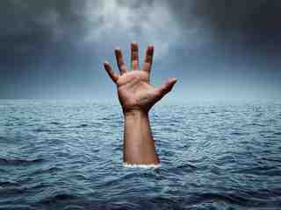
Save Me, O God For the waters have come up to my neck
Hope is Here
Psalm 69:1-12

Slide 2
Luke 24:24-25,44:45
Acts 26:22-23

Slide 3
Psalm 69:1-12 A Cry for Help
1-12 His predicament..
He is drowning..
Weary of crying..
His enemies..
For Your sake
13-28 His prayer..
29-36 His praise..
NT quotations applied to Jesus..
They hated me w/o cause
Zeal for your house
Reproaches fell on me
Let their dwelling place be desolate
Let their table be a snare
But vs 5 cannot apply directly to Jesus..
O God, You know my foolishness; And my sins are not hidden from You.

Slide 4
A Way to look at the Old Testament..
Applying the OT to our lives..
OT individuals suffering for serving God
Acts 7.. The Jews rejected their deliverers
A wicked king taking a man’s vineyard
David was an innocent sufferer
The experiences of Job
Jesus the ultimate innocent sufferer

Slide 5
Save Me, O God For the waters have come up to my neck
Hope is Here
Psalm 69:1-12

