Slide 1
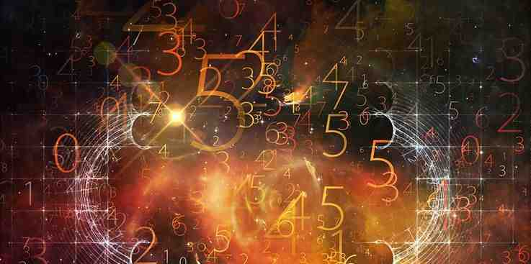
Gospel by the Numbers
5
A Small Number
Five Loaves Multiplied

Slide 2
God uses numbers..
One is the number of priority
Two is the number of choice
Three is the number of confirmation
Four is the number of completeness
Five is a small number (part of something larger)

Slide 3
Why Five seems small
Only one hand.. Five fingers
Five and dime stores.. (don’t spend much)
Take five.. (a short break)
“Five”..
Five senses, Five food groups
Five vowels, Five questions
Five points on star..

Slide 4
Five in the Bible
First five Books.. Pentateuch
10 commandments.. 1st 5 (God) 2nd 5 (man)
Five offerings..burnt, sin, trespass, grain, peace
Parable of wise and foolish virgins
Five miracles of the cross

Slide 5
The Five Loaves
John 6:1-14
After these things Jesus went over the Sea of Galilee, which is the Sea of Tiberias. ² Then a great multitude followed Him, because they saw His signs which He performed on those who were diseased. ³ And Jesus went up on the mountain, and there He sat with His disciples.
⁴ Now the Passover, a feast of the Jews, was near. ⁵ Then Jesus lifted up His eyes, and seeing a great multitude coming toward Him, He said to Philip, “Where shall we buy bread, that these may eat?” ⁶ But this He said to test him, for He Himself knew what He would do.

Slide 6
Five lessons..
1 Don’t forget we have Jesus with us
⁷ Philip answered Him, “Two hundred denarii worth of bread is not sufficient for them, that every one of them may have a little.”
2 Jesus can do a lot more with what we have than we can
⁸ One of His disciples, Andrew, Simon Peter’s brother, said to Him, ⁹ “There is a lad here who has five barley loaves and two small fish, but what are they among so many?”

Slide 7
Lessons of the five loaves..
3 Jesus is able and willing to use what we have and make it worthwhile
¹⁰ Then Jesus said, “Make the people sit down.” Now there was much grass in the place. So the men sat down, in number about five thousand. ¹¹ And Jesus took the loaves, and when He had given thanks He distributed them to the disciples, and the disciples to those sitting down; and likewise of the fish, as much as they wanted. ¹² So when they were filled, He said to His disciples, “Gather up the fragments that remain, so that nothing is lost.” ¹³ Therefore they gathered them up, and filled twelve baskets with the fragments of the five barley loaves which were left over by those who had eaten.

Slide 8
Lessons of the five loaves..
4 Jesus is willing to do what we need even when we don’t really know what we need..
John 6:14 Then those men, when they had seen the sign that Jesus did, said, “This is truly the Prophet who is to come into the world.”
John 6:26-27 Jesus answered them and said, “Most assuredly, I say to you, you seek Me, not because you saw the signs, but because you ate of the loaves and were filled. ²⁷ Do not labor for the food which perishes, but for the food which endures to everlasting life, which the Son of Man will give you, because God the Father has set His seal on Him.”

Slide 9
Lessons of the five loaves..
4 Jesus is willing to do what we need even when we don’t really know what we need..
John 6:32-35 Then Jesus said to them, “Most assuredly, I say to you, Moses did not give you the bread from heaven, but My Father gives you the true bread from heaven. ³³ For the bread of God is He who comes down from heaven and gives life to the world.”
³⁴ Then they said to Him, “Lord, give us this bread always.”³⁵ And Jesus said to them, “I am the bread of life. He who comes to Me shall never hunger, and he who believes in Me shall never thirst.

Slide 10
Five lessons..
5 Many reject Him because they just don’t know what they really need..
John 6:66-68 From that time many of His disciples went back and walked with Him no more. ⁶⁷ Then Jesus said to the twelve, “Do you also want to go away?”
⁶⁸ But Simon Peter answered Him, “Lord, to whom shall we go? You have the words of eternal life. ⁶⁹ Also we have come to believe and know that You are the Christ, the Son of the living God.”

Slide 11
Gospel by the Numbers
5
A Small Number
Five Loaves

