Slide 1
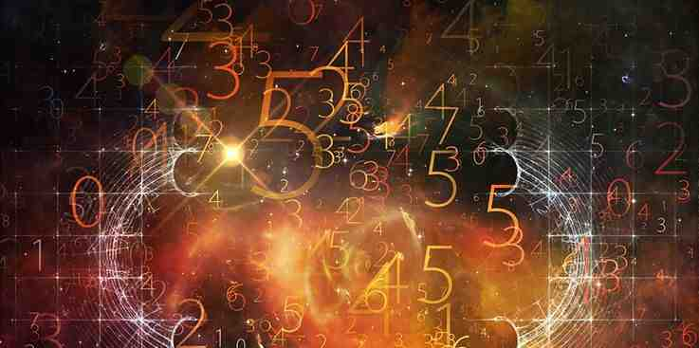
Gospel by the Numbers
The Number of Confirmation
3
Three Witnesses

Slide 2
How numbers are used
1 – Number of Priority
2 – Number of Choice
3 – Number of Confirmation

Slide 3
John’s three witnesses
The Certainty of God’s Witness
1 John 5:6-8 This is He who came by water and blood—Jesus Christ; not only by water, but by water and blood. And it is the Spirit who bears witness, because the Spirit is truth. ⁷ For there are three that bear witness in heaven: the Father, the Word, and the Holy Spirit; and these three are one. ⁸ And there are three that bear witness on earth: the Spirit, the water, and the blood; and these three agree as one.

Slide 4
Witnesses establish what happened..
Matt 18:16 ¹⁵ “Moreover if your brother sins against you, go and tell him his fault between you and him alone. If he hears you, you have gained your brother. ¹⁶ But if he will not hear, take with you one or two more, that ‘by the mouth of two or three witnesses every word may be established.’

Slide 5
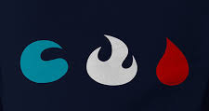
Three Witnesses on earth agree
The Spirit, the water, the blood

Slide 6
Blood is a witness
Genesis 3:15 And I will put enmity Between you and the woman, And between your seed and her Seed; He shall bruise your head, And you shall bruise His heel.”

Slide 7
Blood is a witness
Philippians 2:5-8 Let this mind be in you which was also in Christ Jesus, .. ⁸ And being found in appearance as a man, He humbled Himself and became obedient to the point of death, even the death of the cross.

Slide 8
Blood is a witness
Galatians 3:1 O foolish Galatians! Who has bewitched you that you should not obey the truth, before whose eyes Jesus Christ was clearly portrayed among you as crucified?

Slide 9
Water is a witness
Matthew 3:13-17 Jesus’ baptism confirmed by the Father’s words
Matthew 28:19 Jesus’ final instructions..
Galatians 3:27 as many of you as were baptized put on Christ

Slide 10
Water is a witness
Joshua 4:5-7 “Cross over before the ark of the Lord your God into the midst of the Jordan, and each one of you take up a stone on his shoulder, according to the number of the tribes of the children of Israel, ⁶ that this may be a sign among you when your children ask in time to come, saying, ‘What do these stones mean to you?’ ⁷ Then you shall answer them that the waters of the Jordan were cut off before the ark of the covenant of the Lord; when it crossed over the Jordan, the waters of the Jordan were cut off. And these stones shall be for a memorial to the children of Israel forever.”

Slide 11
The Spirit is a witness
Luke 4:18 “The Spirit of the Lord is upon Me, Because He has anointed Me To preach the gospel to the poor; He has sent Me to heal the brokenhearted, To proclaim liberty to the captives And recovery of sight to the blind,To set at liberty those who are oppressed;

Slide 12
The Spirit is a witness
1 Peter 1:10-12 Of this salvation the prophets have inquired and searched carefully, who prophesied of the grace that would come to you, ¹¹ searching what, or what manner of time, the Spirit of Christ who was in them was indicating when He testified beforehand the sufferings of Christ and the glories that would follow. ¹² To them it was revealed that, not to themselves, but to us they were ministering the things which now have been reported to you through those who have preached the gospel to you by the Holy Spirit sent from heaven—things which angels desire to look into.

Slide 13
The Spirit is a witness
Heb 2:1-4 Therefore we must give the more earnest heed to the things we have heard, lest we drift away. ² For if the word spoken through angels proved steadfast, and every transgression and disobedience received a just reward, ³ how shall we escape if we neglect so great a salvation, which at the first began to be spoken by the Lord, and was confirmed to us by those who heard Him, ⁴ God also bearing witness both with signs and wonders, with various miracles, and gifts of the Holy Spirit, according to His own will?

Slide 14
John’s three witnesses
The Certainty of God’s Witness
1 John 5:6-8 This is He who came by water and blood—Jesus Christ; not only by water, but by water and blood. And it is the Spirit who bears witness, because the Spirit is truth. ⁷ For there are three that bear witness in heaven: the Father, the Word, and the Holy Spirit; and these three are one. ⁸ And there are three that bear witness on earth: the Spirit, the water, and the blood; and these three agree as one.

Slide 15
Three Witnesses on earth agree
The Spirit, the water, the blood

Slide 16
Gospel by the Numbers
3
Three Witnesses
The Number of Confirmation

