Slide 1
Be Strong and Courageous
Joshua 1

Slide 2
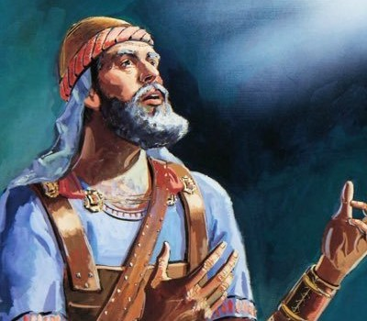
A New Leader
Moses my servant is dead
Arise, Go over this Jordan
Every place you set foot
The land I am giving you

Slide 3
God’s Encouragement
I will be with you
Be strong and courageous
The place of God’s word
God’s success formula

Slide 4
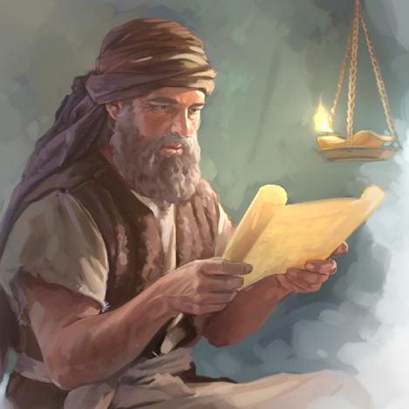
His will for us..
A Pressing Forward Faith
I Will Never Leave You
Be Strong and Courageous
Meditating on God’s Word

Slide 5
Be Strong and Courageous
Joshua 1

